Slide 1
Before we get started…
Welcome, future travelers!
Camera on
Mute on
Sign in!
We also recommend grabbing a pen and paper or a way to jot down questions
Hover camera over QR

Slide 2
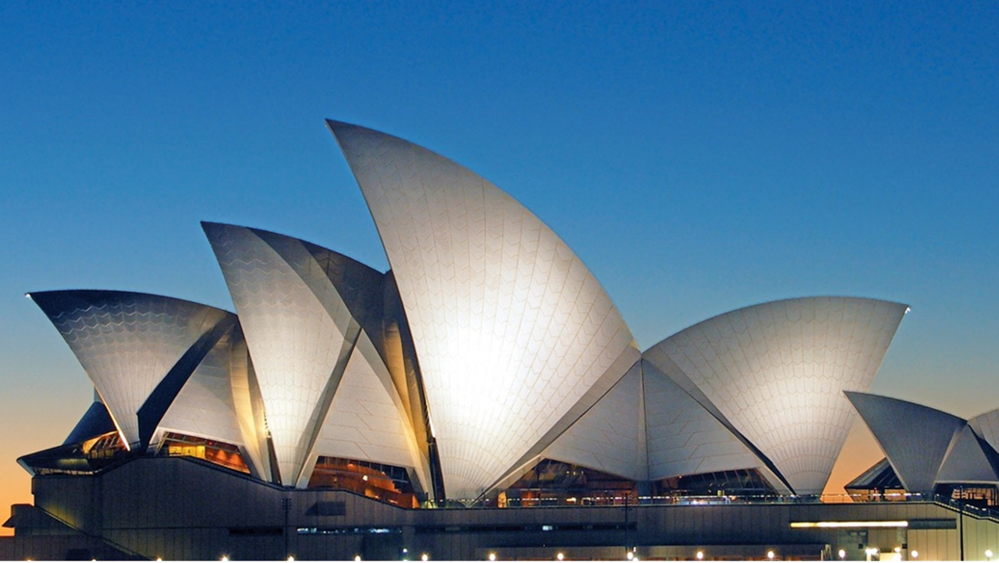
Let’s go to…
Australia &
New Zealand
✈
15 Days – Expedition of Australia and New Zealand
Notes:
Welcome/ Thanks for coming to learn about this exciting opportunity for your child to travel abroad on an educational tour.

Slide 3
Our agenda
What we are going to cover
Safety and our EF partnership
Travel plans and tour itinerary
What students gain from travel
What’s included (and what’s not)
Price and dates to mark in calendar
Enrolling and submitting questions
Notes:
SPEAKER:
[Safety & our EF partnership]
Safety is at the top of everyone’s mind so we’ll be addressing it first
[Our travel plans and tour itinerary]
Where we’re going and what we’ll be doing
[What you’ll gain from travel]
This isn’t a vacation, folks! It’s educational and truly transformative
[What’s included (and what’s not)]
The long list of items included in your tour
[Price & marking your calendars!]
[Enrolling and answering your questions]
We’ll wrap up the meeting by opening enrollment and submitting your questions using the sign in form!
This link brings you to the sign-in form I just mentioned, please submit your forms at the end of the meeting. Keep them open through the meeting in case you have questions that arise. I’ll respond to everyone’s submitted questions following the meeting!
And with that, let’s dive in!
GOAL:
Let families know what’s in store

Slide 4
My name is
First, just a little about me…
Why I travel…
Incredible personal growth for students
Notes:
SPEAKER:
[First just a little about me…]
I teach Theatre.
I’ve worked at the school for 11 years
[Why I travel…] (insert your own reasons for prompts below)
My first travel experience was transformative… [describe experience]
It changed my life by…
[I’m offering this experience because of the impact travel has on students…]
Changes student’s lives
Helps differentiate students on their college applications
Makes them more confident, independent, outgoing, etc.
Expands student’s knowledge of the world around them
Helps increase cultural awareness and understanding
Fun! Something to look forward to.
Tell 1-2 stories of how you’ve seen travel positively impact your students (if applicable)
GOALS:
Inspire families, and help them understand the true value of travel and how it will impact students

Slide 5
EF Educational Tours
Our educational travel and safety partner
Notes:
SPEAKER:
Before we dive into the incredible itinerary we’ve selected for our trip – I want to talk about our travel & safety partner.
I’ve chosen to partner with an organization called EF Educational Tours for two key reasons.
[55+ years]
They have 55 years of experience which means they have seen it all and know how to respond.
[Staff on the ground in over 50 countries]
EF always knows what is happening on the ground which is critical in an everchanging environment
They know how to safely navigate a city as true locals
They have an office close to us on tour in case we were to need extra support
[World Leader in international education & accredited]
EF is an accredited educational organization, just like our school. We’re going to have fun but also learn a lot too!
I feel extremely confident that partnering with EF is the best way to stay safe and healthy while having a life-changing experience. I’m going to go into more detail in a couple slides!
To Learn More:
To learn more about EF, everything you need can be found on our tour enrollment page, which I’ll share with you at the end of this meeting.
GOAL:
Explain reasons for partnering with EF.
Mention EF’s experience, worldwide presence, and educational focus.

Slide 6
Notes:
SPEAKER:
EF is the largest provider of educational student travel in the area
Many schools and teachers in our area already partner with them
Here are some examples of schools actively traveling with EF…
Sample Talking Points:
EF is proven and tested in our community/district
I’ve spoken with other teachers in the area that have used them
Most schools in our area (district) partner with them already
GOALS:
To build trust in EF, help parents understand that partnering with EF is normal in the area
EF is the familiar name in the area for student travel
EF works with many nearby schools already, so we are proven, tested and experienced

Slide 7
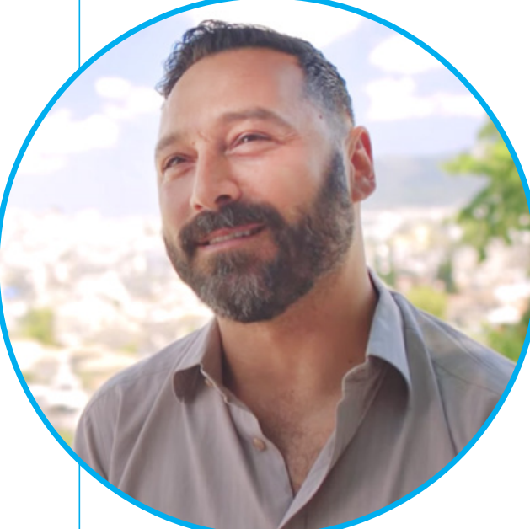
Safety on tour
Local support and insight
"Whether a student loses a passport on tour and the EF Emergency Hotline is needed to provide assistance or most recently...because of COVID-19, EF Tours has prioritized our travelers’ safety experience at the heart of their actions.”
Michael G., New Jersey Group Leader
EF provides our group with
A dedicated, personal Tour Director
Safety & Incident Response Team
Enhanced safety precautions and procedures
Support for my safety policies
Notes:
SPEAKER:
I know that safety is at the top of everyone’s mind, so I want to address it up front. The first thing you should all know, is that I’ve done my research and feel incredibly confident partnering with EF.
Sample Talking Points:
EF has our back, they’ve thought of everything and I trust their safety policies
They have multiple programs in place to help keep us safe
EF will be right there to support us (locally, globally, pre-tour and on-tour) to help us through any situations that arise
Bottom line: we are safer traveling with EF than we ever would be on our own.
They have policies to protect our investment pre-tour (which will cover in a minute), but they also provide us with a lot on tour:
[Personal Tour Director]
Our own personal Tour Director knows the area well and are likely from one of the places we are visiting
They are with us the whole time from the time we land on day 1 to waving us goodbye on the final day
[Safety & Incident Response Team]
• EF’s has a team of experts located around the world, their #1 priority is safety
• They are always ready to respond to ensure that a train strike or a sprained ankle won’t slow us down
Their emergency support team is available 24/7, 365 days a year
[Enhanced safety precautions and procedures]
EF has enhanced safety precautions and procedures that cover everything from cleanliness to adjusting tours as needed.
[Chaperones on tour]
• Aside from myself and the Tour Director, for every 6 travelers, our group has the ability to bring an additional chaperone
[My Safety Policy/ My expectations]
This is an extension of the classroom so all school rules apply
Keep in mind, you are representing your school, state and country. Make us proud!
GOAL:
Continue to build trust in EF
Help parents understand how we help keep students safe

Slide 8
Peace of Mind Programs
These benefits are built into every EF tour.
They provide groups and travelers with flexibility to change the dates and destinations of their tours in uncertain times.
Book with confidence
Global Travel Protection
Available to all travelers, this plan provides both pre-departure and post-departure benefits.
Notes:
SPEAKER:
EF is offering a few things to help us protect our investment, to give us the confidence to book our travel experience now, while monthly payments are so affordable. Here are some of the ways that EF is protecting our investment:
[Peace of Mind]
EF’s Peace of Mind Program gives our group the flexibility to modify our tour or dates if we’re uncomfortable traveling as we get closer to departure.
[Global Travel Protection]
Custom-designed travel protection unique to EF, provides both pre-tour and on-tour benefits.
(if built into tour cost): and I have built that into everyone’s experience to give you additional coverage
(if optional): this can be added when you enroll for an additional cost
[Risk-free enrollment period]
Finally, I mentioned this earlier, but EF is also offering us a Risk-Free Enrollment Period right now. This mean that if you enroll now, and your situation changes, you can cancel for any reason before May 1, 2021 and receive a 100% refund.
I hope these help give you all comfort and confidence to book your experience now, despite the uncertain times we live in today.
For More Information:
If you want more information on ANY of these programs, you can read all the fine print on our Tour Enrollment Page which I’ll be sharing at the end of this meeting.
GOALS:
Help parents understand that their investment is protected (both from a safety and financial standpoint)
They can research more on their own through your Tour Enrollment Page

Slide 9
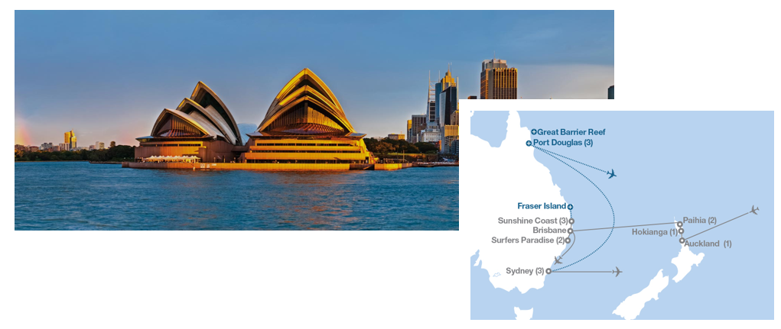
Our Itinerary
What we’ll see, do, eat, and experience
What are
you excited
about?
Notes:
Now let’s talk about our tour!
Take the next minute to look at the itinerary I just handed out As you can see it’s action packed. I could go through each day, minute by minute, but as I mentioned in the beginning I want to be respectful of your time. So I picked out a few of sites that I’m most excited for the students to see. We will take a peek at those in just a minute.

Slide 10
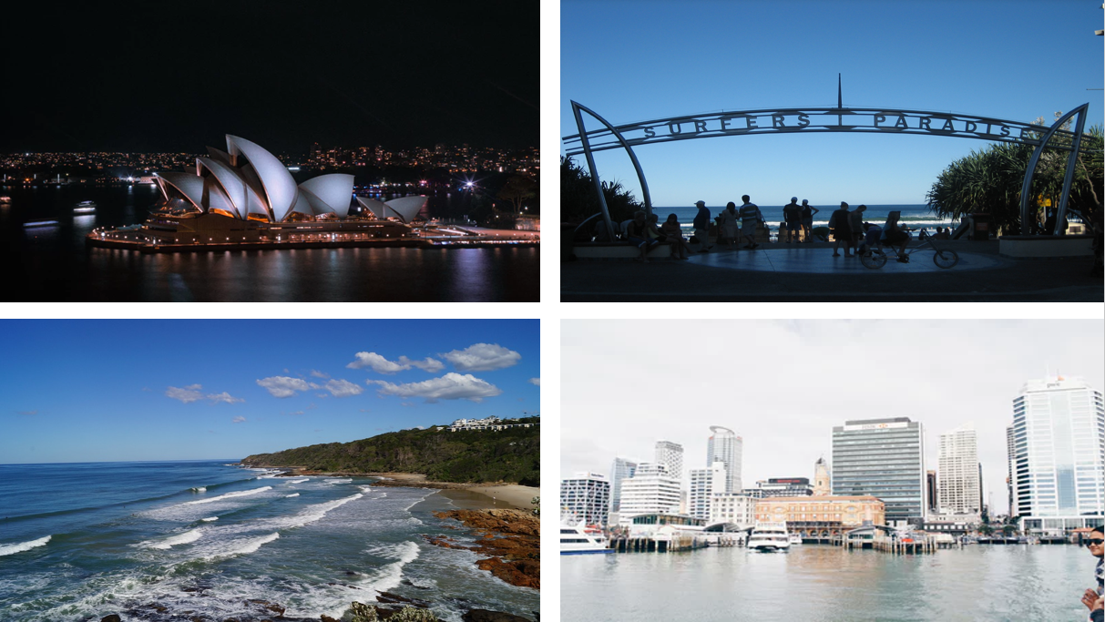
SYDNEY
SURFER’S PARADISE
SUNSHINE COAST
AUCKLAND
Notes:
Check out some of the amazing places we get to go!

Slide 11
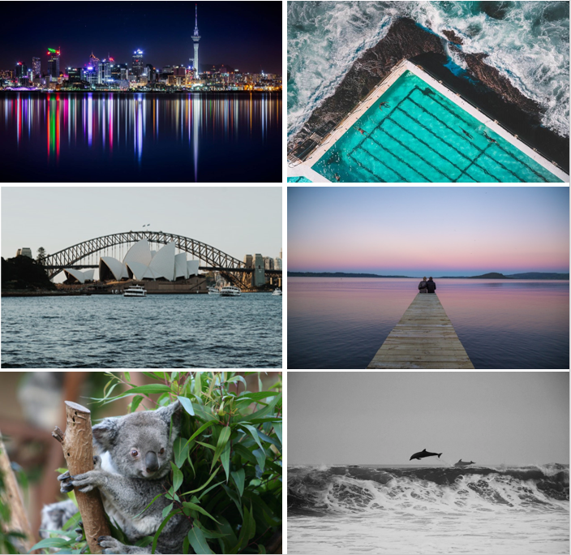
HIGHLIGHTS
Tour of Auckland
Visit a marae, a Maori meeting house
Cruise around the Bay of Islands
Visit Sydney Tower
National Opal Collection
Explore Surfers Paradise

Slide 12
Personal Learning
Building college confidence and earning college credit
HIGH SCHOOL CREDIT
COLLEGE CREDIT
COLLEGE APPLICATIONS
Earn credit
with a personal
project
Complete college-level work to earn 3 credits
Use your tour to inspire a personal essay
Notes:
SPEAKER:
We just heard about how educational travel impacts a student’s personal journey but also prepares them for the future.
To take it to the next level there are three ways to continue personal and educational growth:
[High School Credit]
Option of earning FREE high school credit: EF is accredited just like our school
[College Credit]
Option of earning 3 college credits through a course from Southern New Hampshire University.
The course is $215 and the credits are fully transferable (which is an amazing deal).
You can add this college class when you enroll
[College Applications]
The Uncommon App is a tool designed to help students structure their personal essays for college applications
College essay prep courses can cost thousands, this is included with our tour at no additional expense
GOAL:
Inform parents and students of the other educational resources available to them through EF that will help them prepare for the future along with their tour
For More Info:
For more information visit: https://www.eftours.com/credit

Slide 13
Group Travel
More friendships for a more affordable price
To keep the tour affordable, our group could be combined with another school
Closer to departure, we’ll be paired with a group who has similar dates and destinations
A great opportunity to meet students from another part of the country
Notes:
SPEAKER:
Group travel is different than individual travel. If we don’t fill a coach bus on our own, EF will pair us up with students from other schools around the country who are requesting similar tours, during similar dates – so that we can experience the trip together.
[Matching up groups keeps our tour affordable]
It allows us to get the best rates and activities
[Closer to tour, we’ll be matched with another group with similar dates and tour]
We have to be flexible with both our tour and our departure dates, we’ll know our exact tour and date 3-5 months prior to tour
[Opportunity to meet students from another part of the country]
If we do get matched with another school, they could be from anywhere in the US, giving us a “double-cultural experience” – cool, right?!
GOAL:
Families understand the flexibility required by group travel.

Slide 14
Notes:
SPEAKER:
[So, what’s included?]
A TON
Directions: read through each one.
[Not included]
A few things. But no real surprises here.
As we get closer to departure I’ll hold a meeting for our enrolled travelers to talk through passports, tips, etc.
For those of you who would like to enroll in college credit, it is an option during enrollment and can be divided into your monthly payments
GOAL:
Build the value in the experience, through everything that’s included

Slide 15
Notes:
SPEAKER:
And finally, here is why we’re planning so far in advance. EF offers a variety of ways to pay for this experience. The easiest and most common ways to pay are the bi-weekly and monthly payment options, which allow you to budget for your tour just like any monthly expense.
[Bi weekly]
Bi-weekly payments are (X dollars) after the initial 95 dollar deposit
[Monthly]
The most popular way to pay with EF is on a monthly basis, and if you enroll by our deadline, the monthly payments are (X dollars) a month.
[Pay in full]
For those who want to pay in full you can do that too
[Manual]
If you need more options, you can also select EF’s manual payment plan which follows a set invoicing schedule. Just give EF’s Traveler Support team a call and they can help. This plan does require some additional fees paid upfront in addition to the $95 deposit.
[Adults can travel too]
Same easy options. Price is a bit different because of rooming.
GOAL:
Show parents how affordable travel can be when they pay monthly or bi-weekly

Slide 16
GLOBAL CITIZEN SCHOLARSHIP
CUSTOMIZABLE TOUR
DONATION PAGE
Submit an application for a needs- and merit-based scholarship
Send your donation page link to friends, family, and loved ones
Notes:
SPEAKER:
We have a couple additional opportunities to fund your travel.
Student can help out too, this isn’t all on your parents!
[Global Citizen Scholarship]
$1,000 needs & merit-based scholarship
To be eligible, complete application and submit a 2-3 minute video on how will this tour change the way you think, feel, or act about the world?
For important dates, visit the EF Global Citizens page (link below)
[Personal Tour Donation Page]
Once you enroll, you can send out your personal tour donation URL from your traveler page.
This page works just like a “Go Fund Me page” but better because you see 100% of the donations applied to your tour balance
Great for holiday/birthday gifts, payment for baby sitting/mowing lawns, or just sending to friends/family who want to help you see the world!
GOAL:
There are a lot of supplemental funding options available to families to budget!
MATERIAL REFERENCE:
For more info, visit eftours.com/global-citizen

Slide 17
Notes:
SPEAKER:
Ready for the trip of a lifetime?! Time to mark your calendars!
We’ll be leaving as early as: (earliest departure date)
And we’ll be returning no later than: (latest return date)
Keep this block of time reserved in your calendars for now, so you don’t book anything that conflicts with these dates.
We’ll know our exact travel dates 3-5 months before tour
GOAL:
Transparency around potential travel dates
Show parents the full range of potential travel dates
Have parents block their calendars now, so they have no date conflicts down the road
Explain that exact travel dates will be finalized 3-5 months prior to tour

Slide 18
Can you spot the Opera House
from the top of Sydney Tower?
Notes:
SPEAKER:
Directions: Read from slides
GOAL:
Hypes up and reminds students and parents why they want to enroll!

Slide 19
Enjoy the tour of New Zealand’s
largest city
Notes:
SPEAKER:
Directions: Read from slides
GOAL:
Hypes up and reminds students and parents why they want to enroll!

Slide 20
Paddle through Australia’s
Sunshine Coast
Notes:
SPEAKER:
GOAL:
Hypes up and reminds students and parents why they want to enroll!

Slide 21
Time to enroll!
$95 deposit secures your spot!
8
Notes:
SPEAKER:
I can’t wait to experience this trip with all of you. At this point, enrollment is officially open!
[Guaranteed Spots available]
I have (8) spots available on this trip.
[Enrollment closes]
My goal is that you can register as soon as possible so you can take advantage these affordable monthly rates before they’re gone.
Additional Talking Points:
There are so many people interested in this experience:
State # of total people interested
State # of people/families present in the meeting
State # of families who expressed interest that couldn’t make the meeting
I anticipate that this trip will be very busy
Please keep that in mind, if this is something you are interested in doing, I would do it right away
So you can grab one of those spots before they’re gone
And so you can take advantage of the risk-free enrollment period as well
GOALS:
Mention the overall level of interest in the community, to help give parents perspective
Explain the benefits of enrolling now (discount, low monthly payments and risk-free enrollment period)
Get families excited to enroll quickly, while this is top of mind

Slide 22
Enrollment is open!
Notes:
SPEAKER:
So, how do you enroll on this experience?
This is the link to our Tour Enrollment Page which has everything you need to register. Write it down!
(put link it chat if possible)
I’ll be sending an email after this meeting with this link as well
[OUR ENROLLMENT PAGE]
Our enrollment page will cover all the details (specific to our tour) that I went over today.
The easiest way to enroll is online but you can also call EF, let me know if you’re interested in that option through your sign-in form
[OUR ENROLLMENT NUMBER]
The enrollment number will be helpful to reference if you do call in by phone
[SIGN-IN FORM]
Please remember to turn in your sign in form so I can:
Get a headcount of who is planning to enroll
See who attended tonight
And answer your lingering questions in a timely manner
If you didn’t pull it up at the beginning, I have the URL listed here as well.
[CLOSING REMARKS]
Directions: Stop sharing screen and go into gallery view
Speaker Tips:
Thank everyone for coming
Leave group with one final message of inspiration and hope
Final opportunity to explain why you’re hopeful families will enroll and why you’re excited for this experience
GOAL:
Teach families how to enroll
Remind them to submit their sign-in sheets
Thank them for coming and leave them with one final inspirational message

