Slide 1
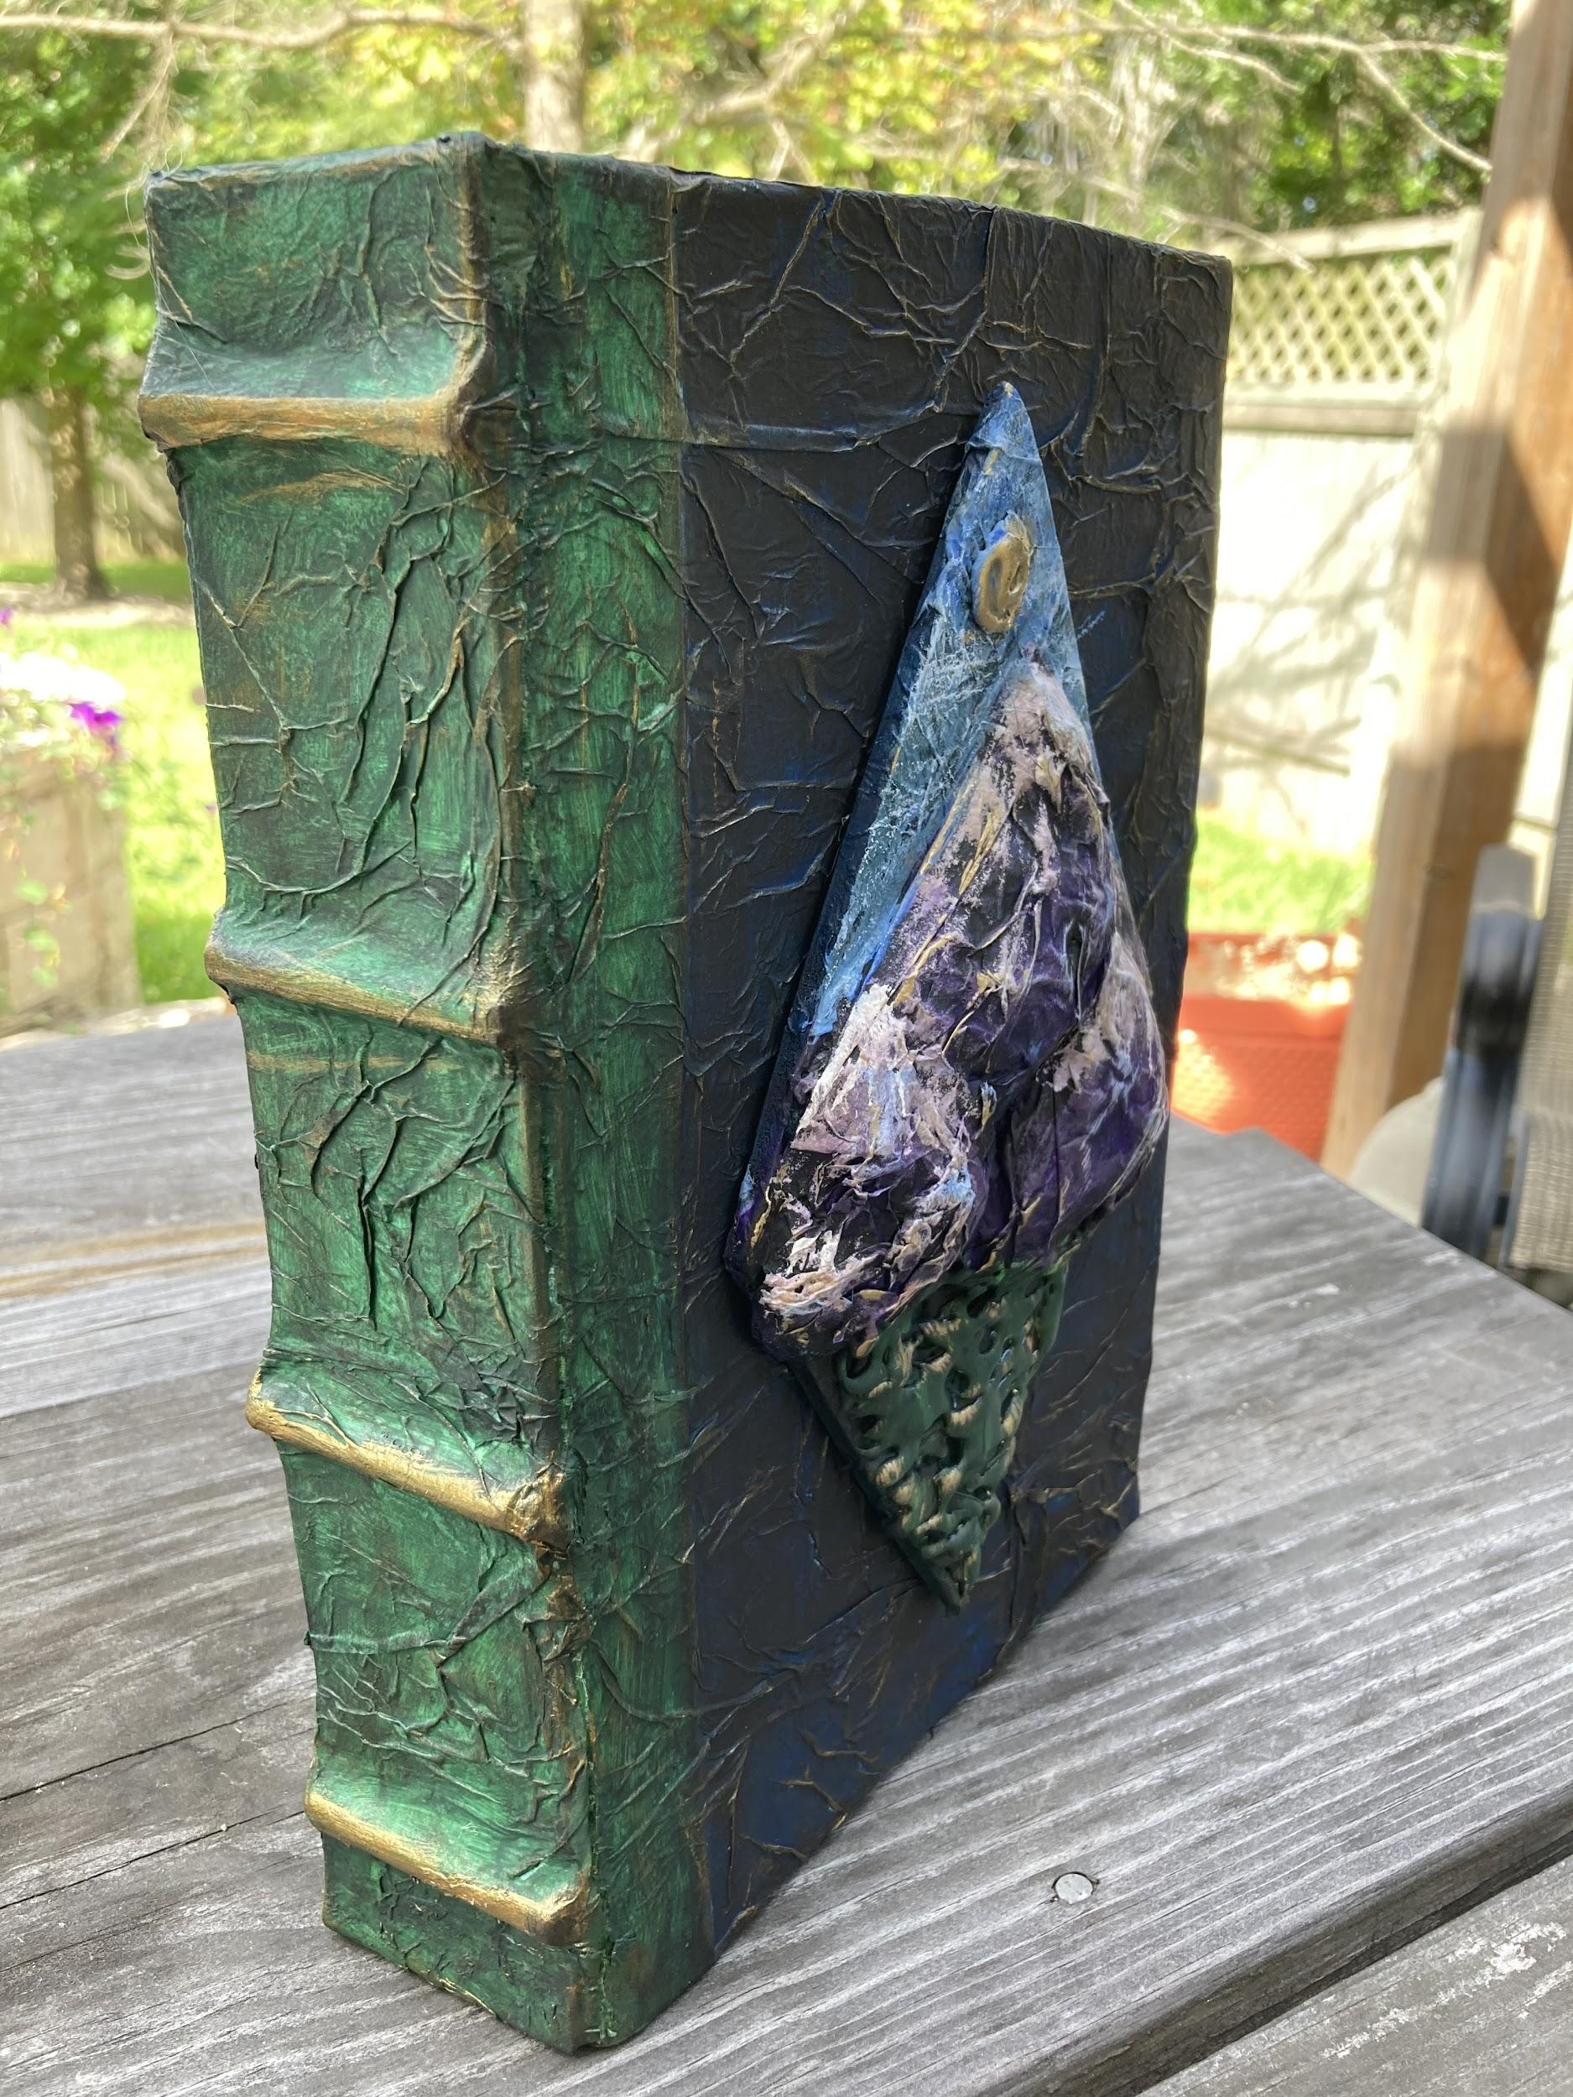
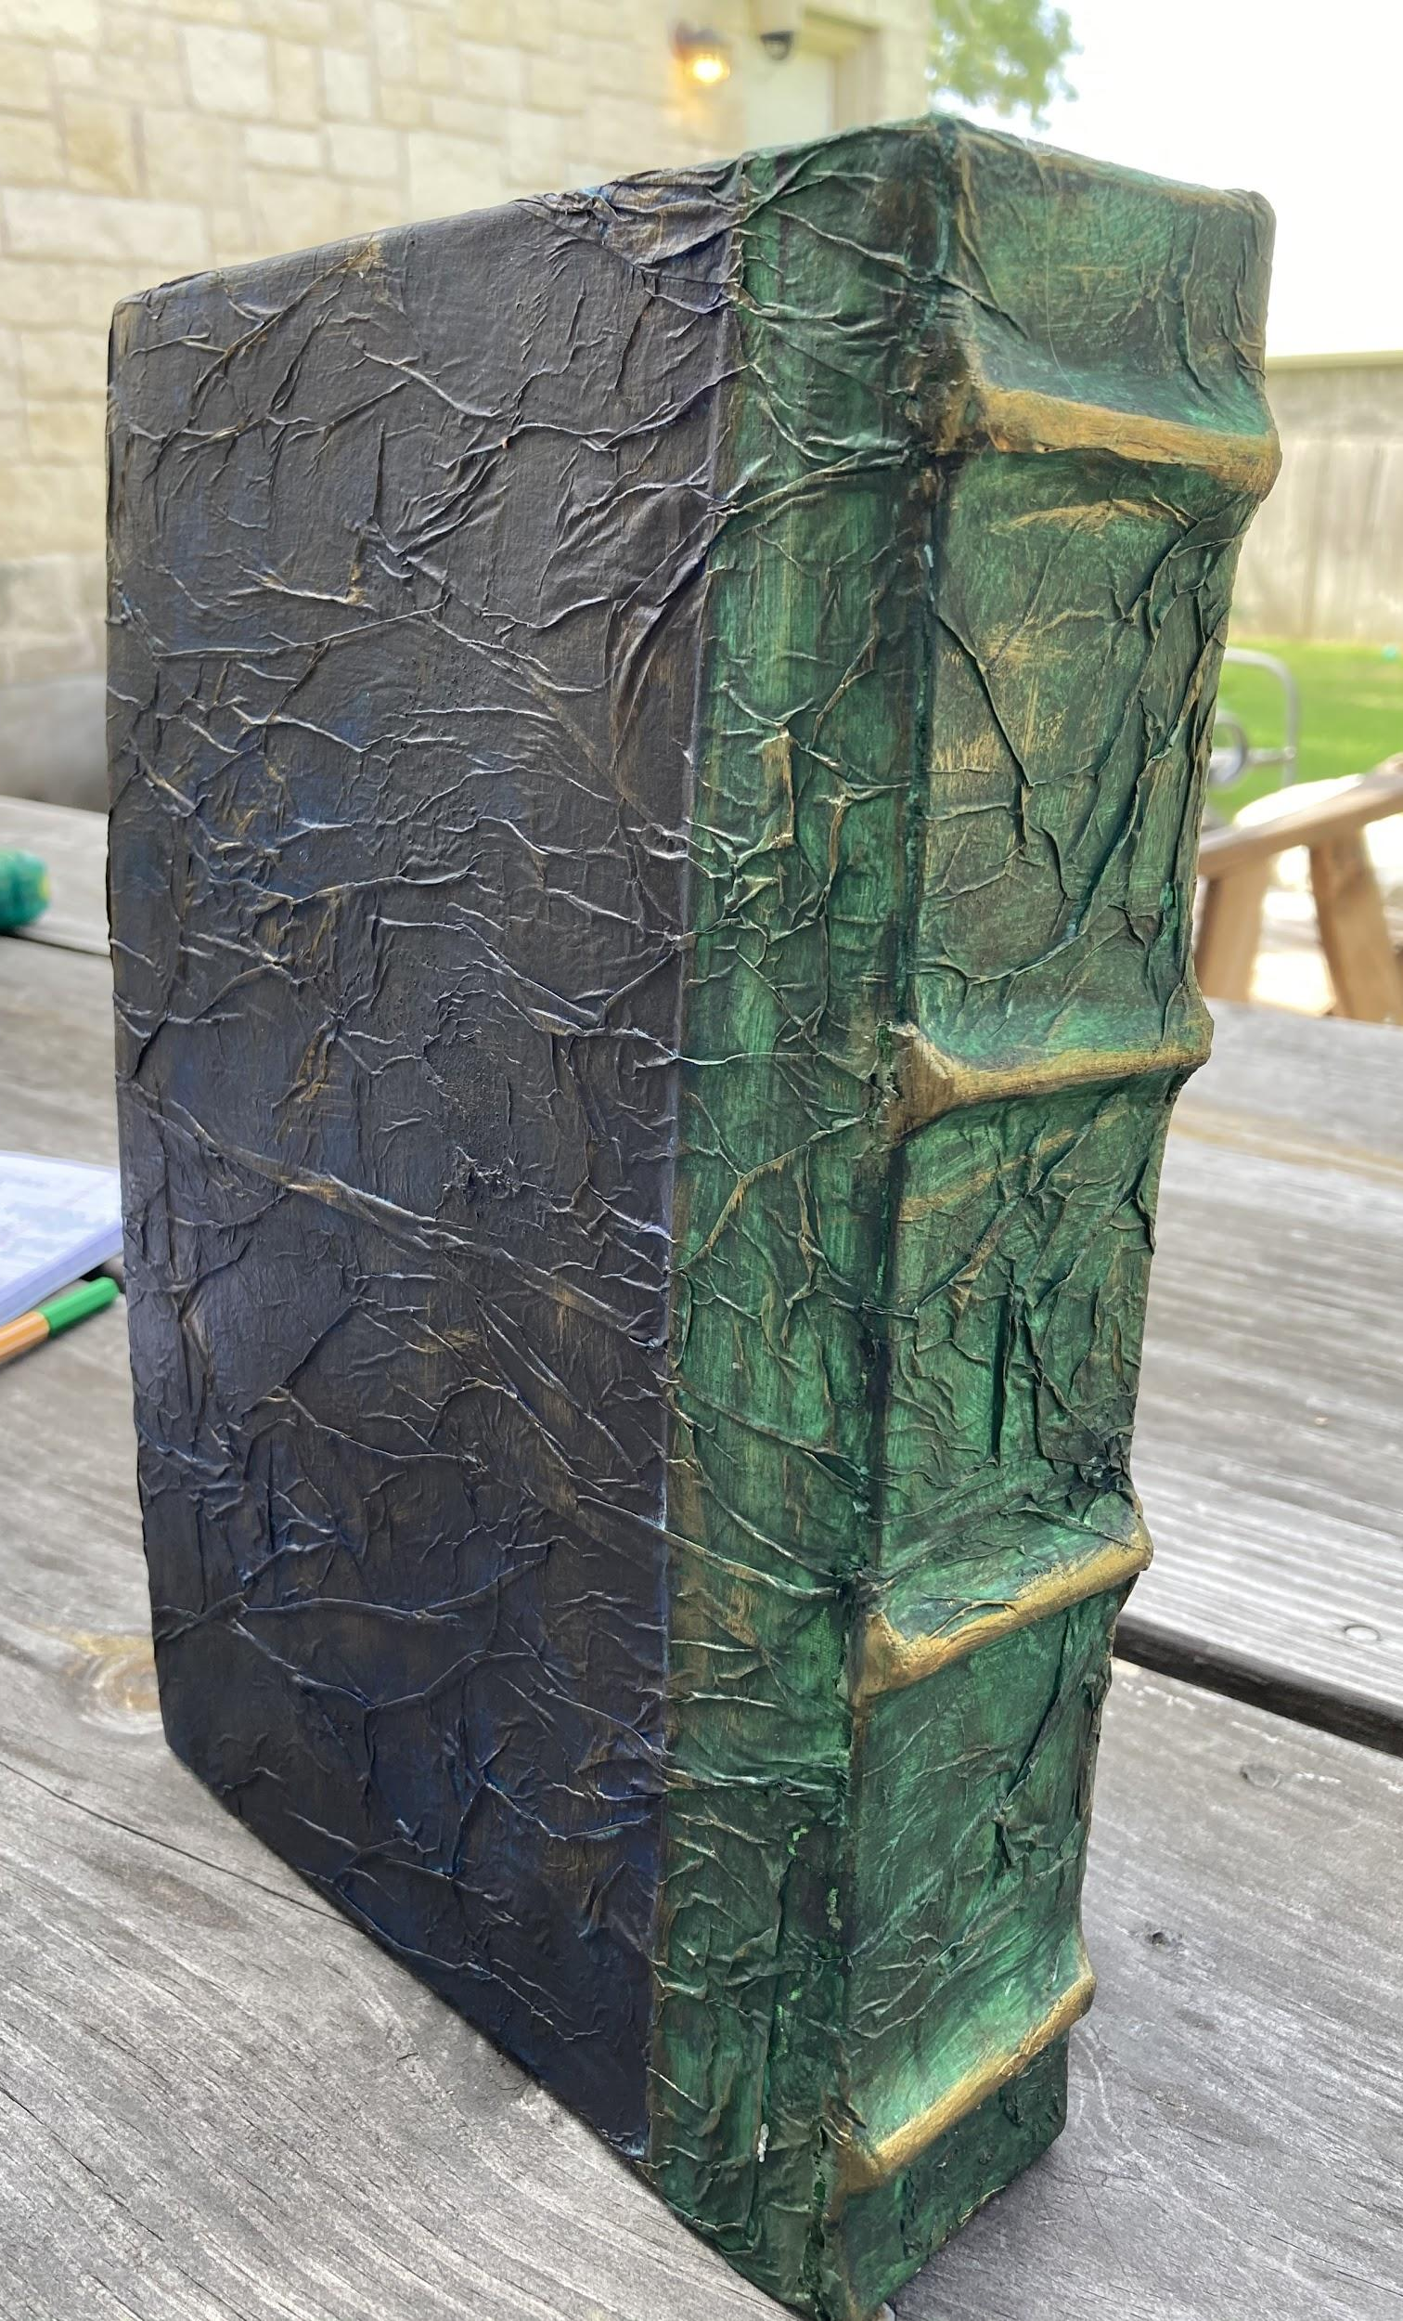
Properties Design - Cereal Box Book

Slide 2
Objectives
WE WILL:
Recognize, identify, and implement the elements & principles of design as it pertains to scenic design.
I WILL:
Create a rendering utilizing the entirety of the design process.

Slide 3
TEKS Technical Theatre 1
1.E read scripts and apply basic script analysis techniques to technical theatre elements.
2.B recognize the design process of analysis, research, incubation/selection, implementation, and evaluation to a theatrical product such as a rendering, model, and sketch;
2.E define creativity as it relates to personal expression in technical theatre and design;
2.F recognize communication methods between directors and designers such as prompt book, costume plot, light plot, makeup, theatre management, property list, design renderings, and models; and
4.A conduct research to establish historical and cultural accuracy in theatrical design;
5.C recognize the design and technical elements of theatre as an art form and evaluate self as a creative being;
5.G use technology to communicate and present findings in a clear and coherent manner.

Slide 4
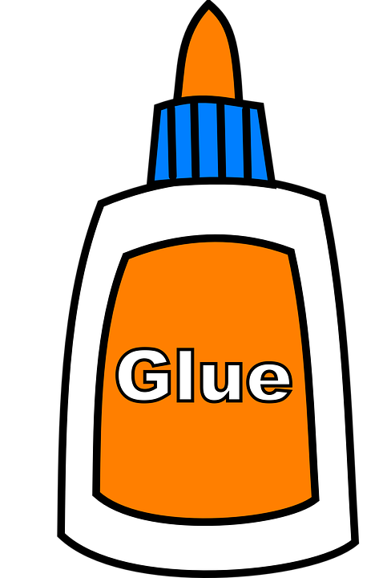
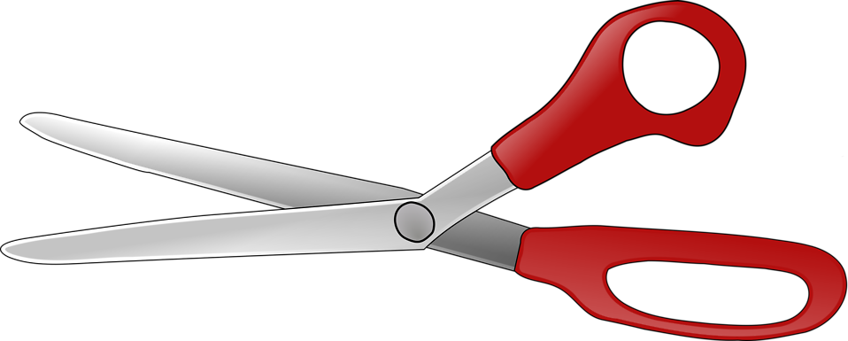
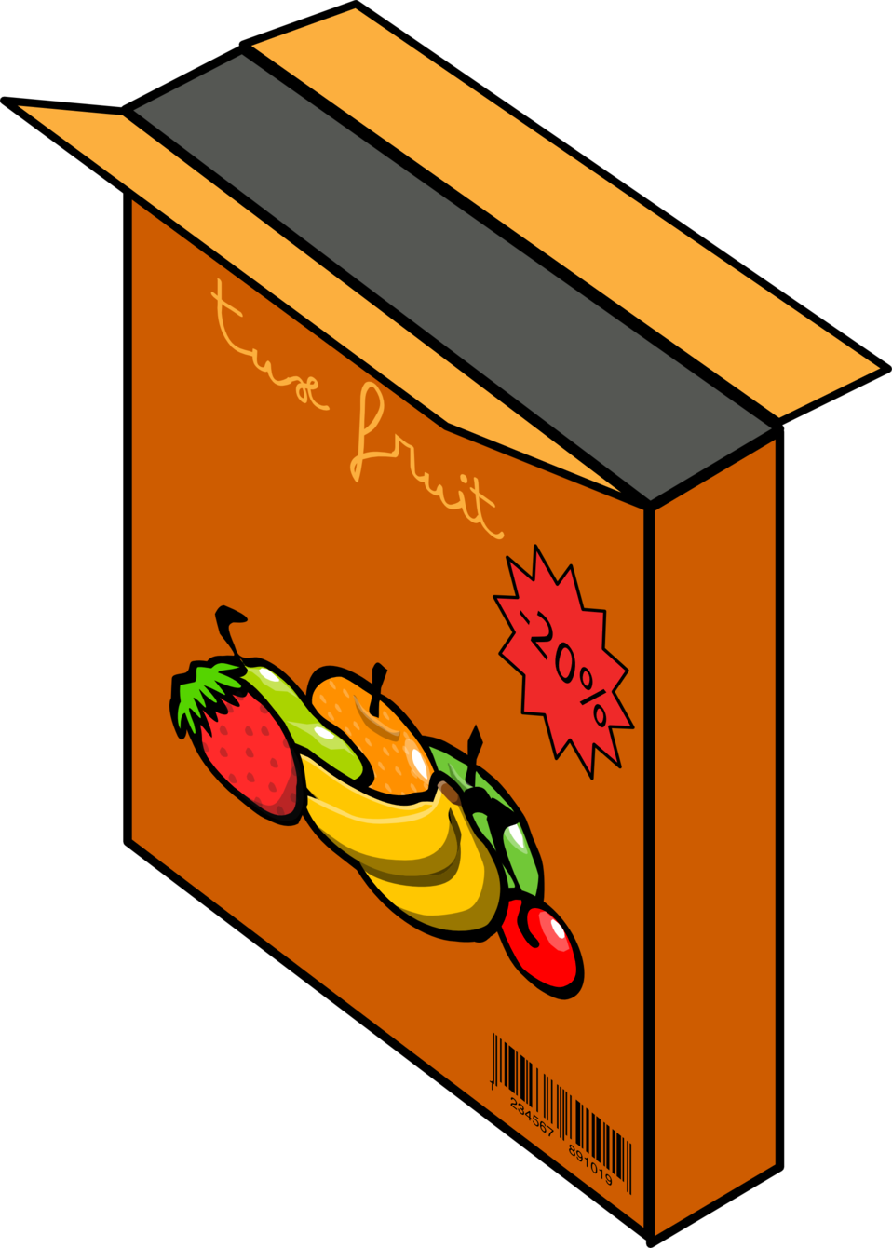
Materials Needed
Scissors
A Sharpie
Elmer's Liquid Glue
Hot Glue Gun (Really Helps!)
A Cereal Box
A Straw
Fabric
Paper
Coffee or Tea

Slide 5
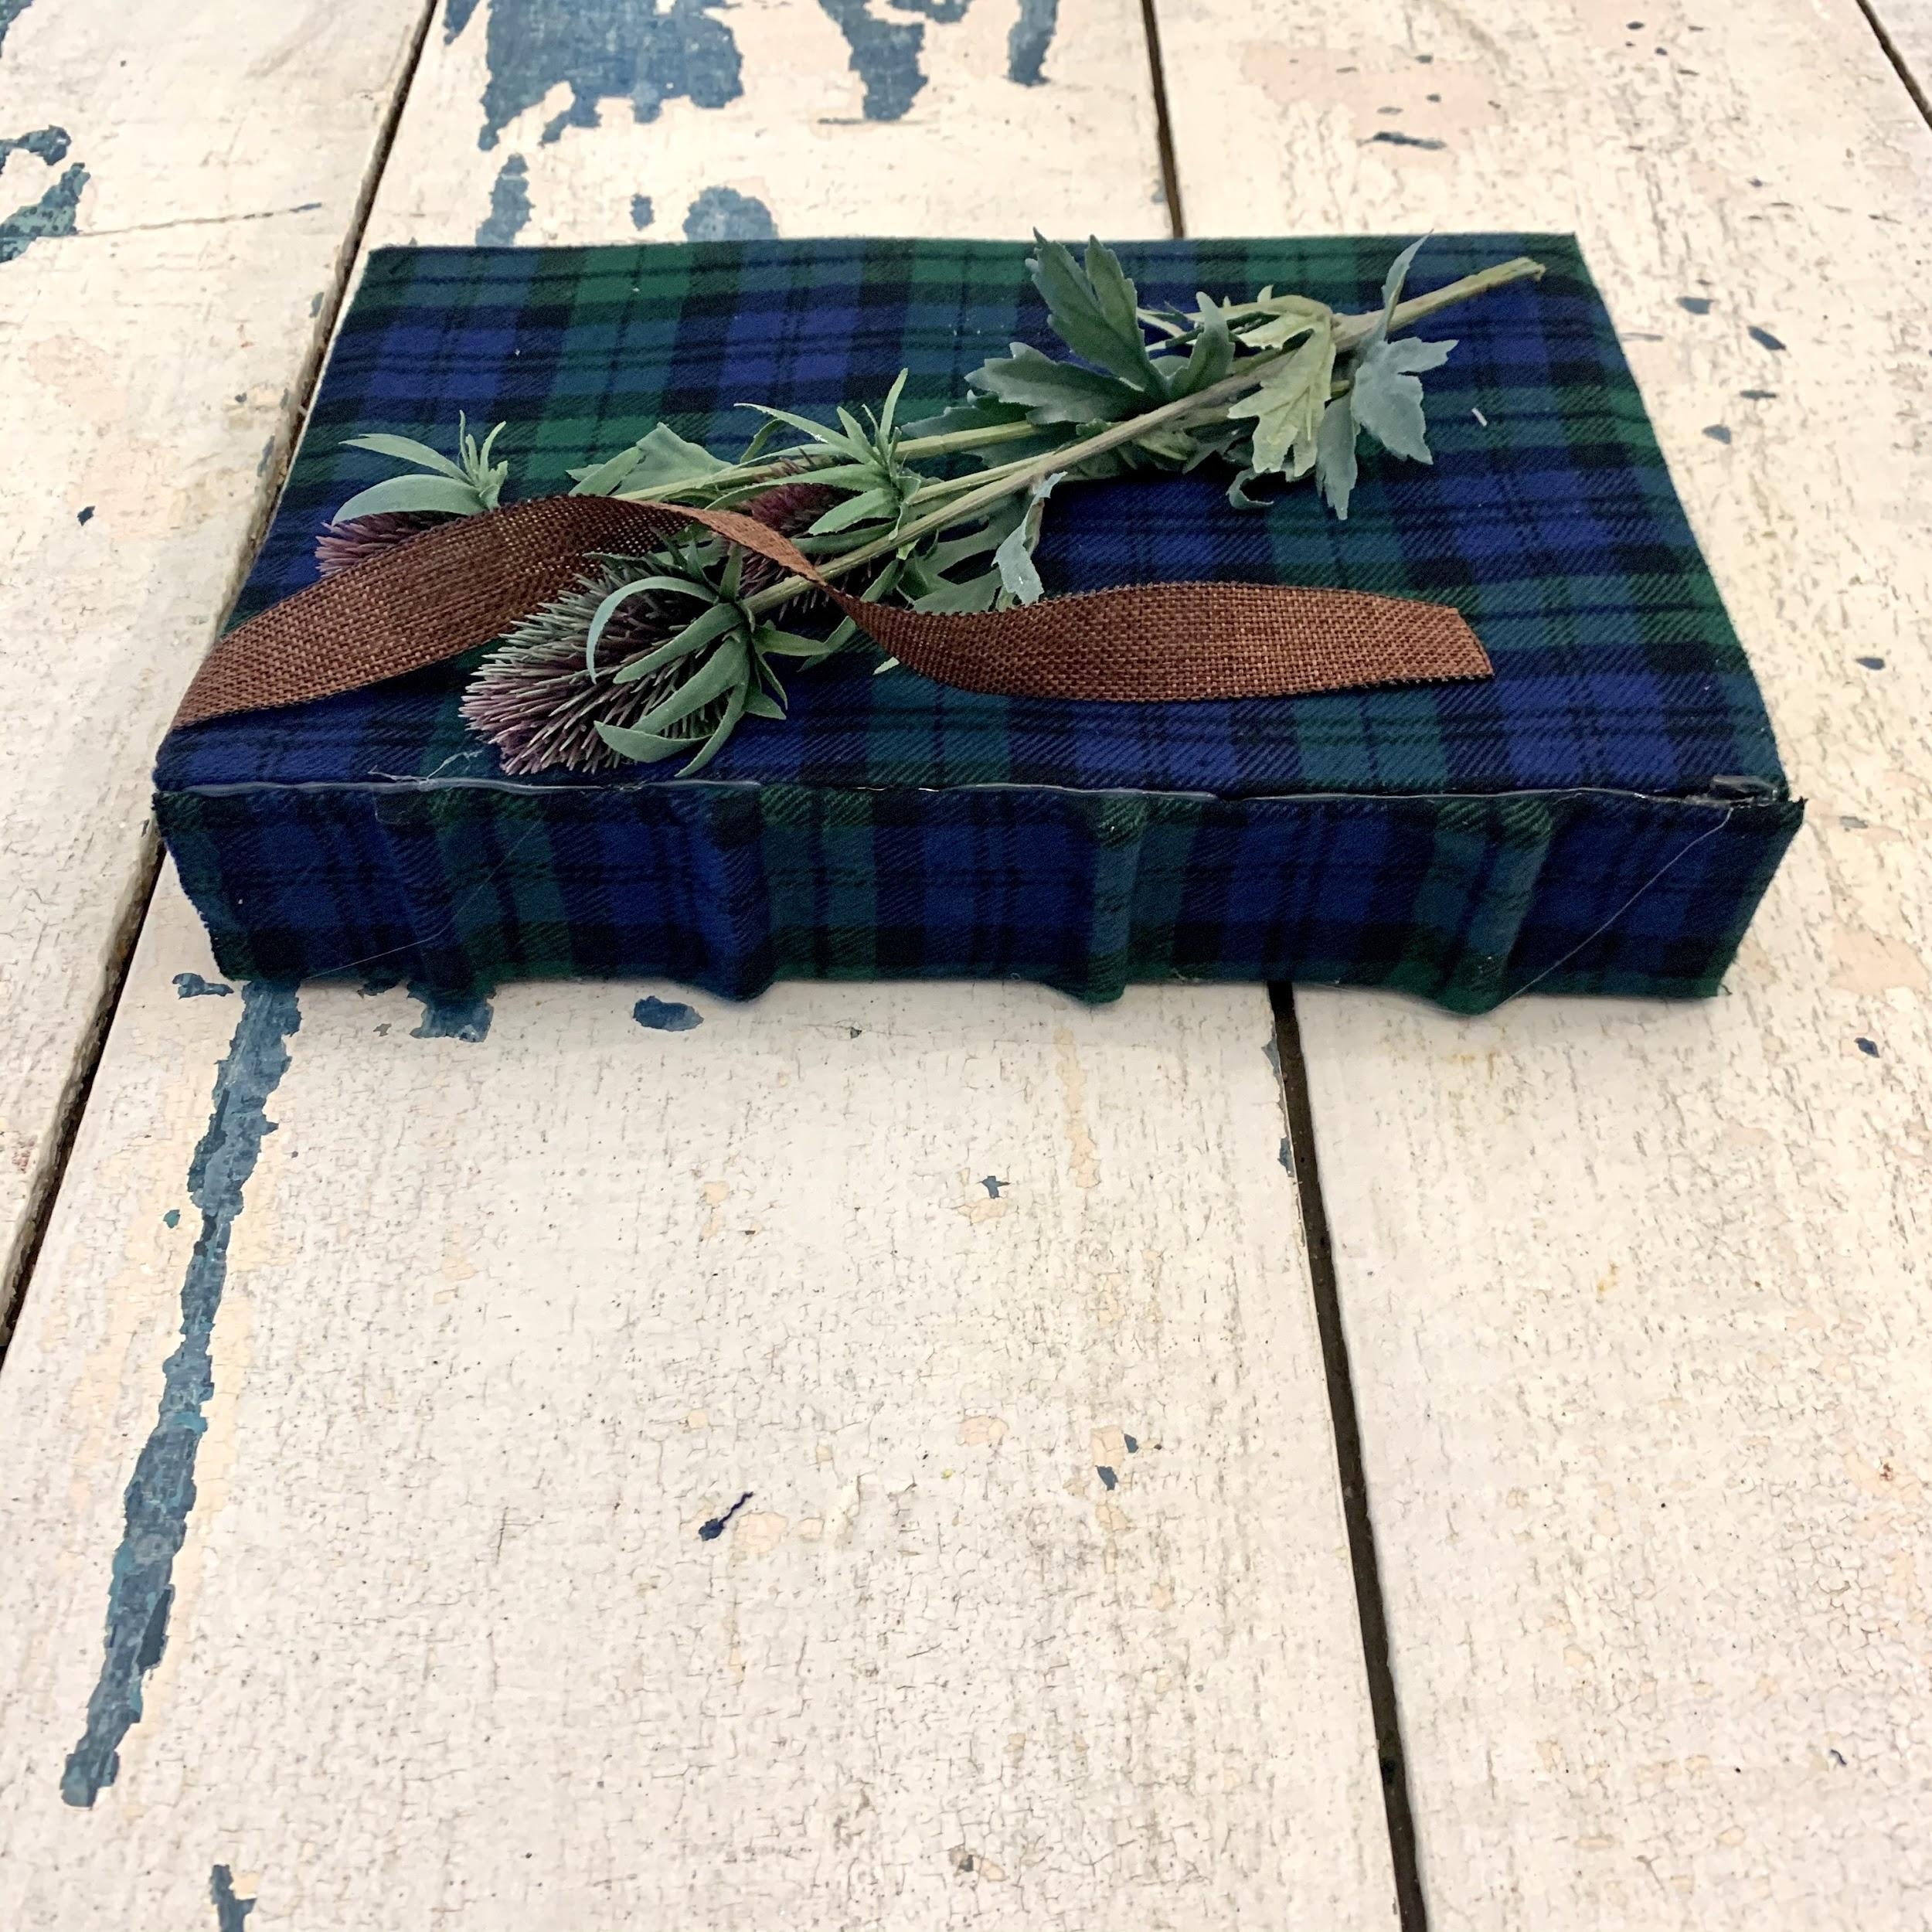
Start with a plan!
Your book needs to have a theme. The two you’ll see below give a good example of a theme. The theme will inform your decisions on color and features.
Smoky Mountains
Scotland

Slide 6
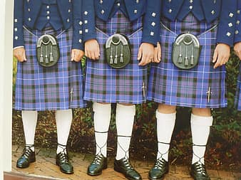
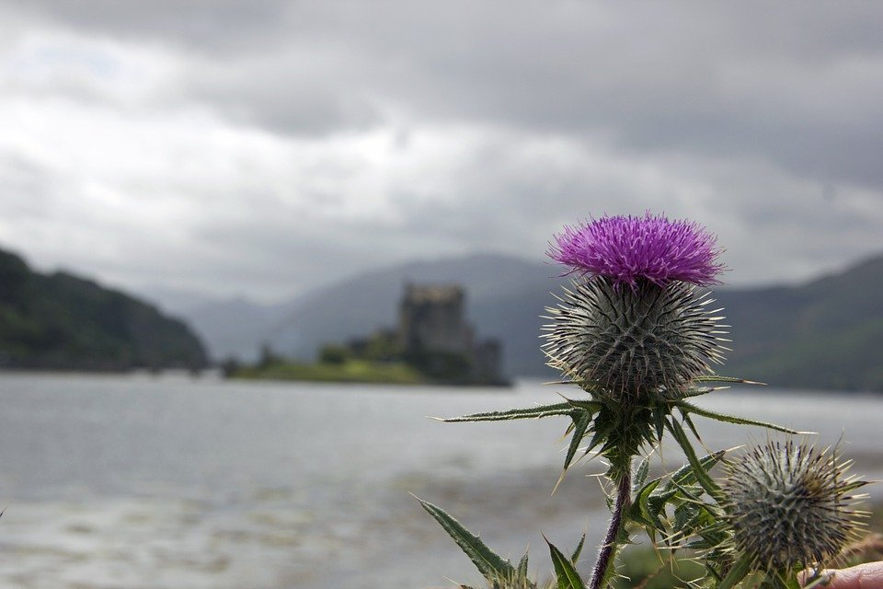
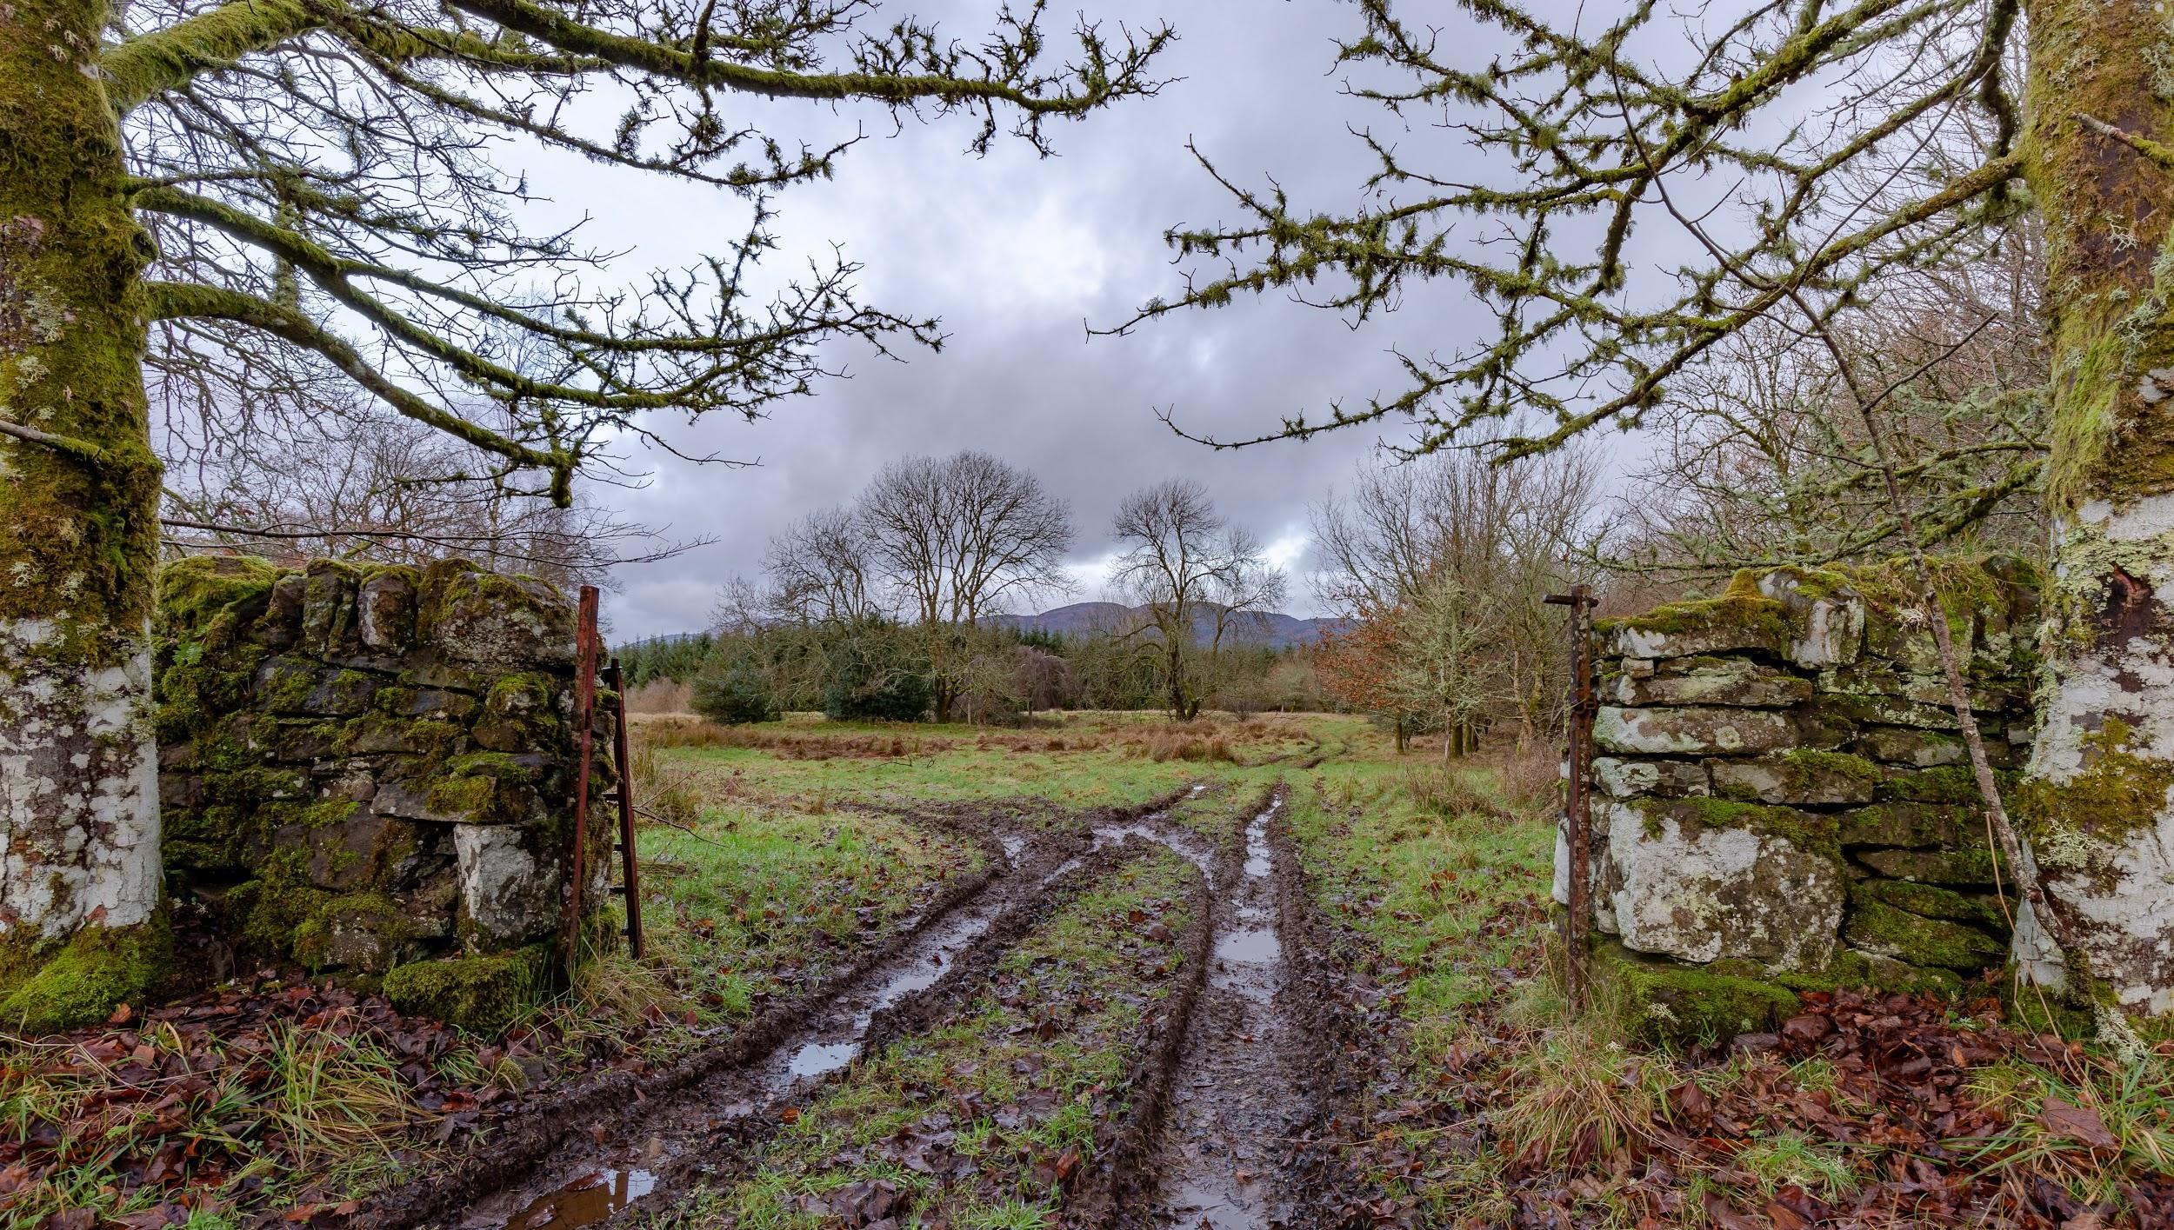
Inspiration and Research Photos
On the next slide, you’ll be giving a visual representation of your theme. You’ll need to upload 3-5 pictures. Below are some pictures that inspired the Scotland book.

Slide 7
Your theme:

Slide 8
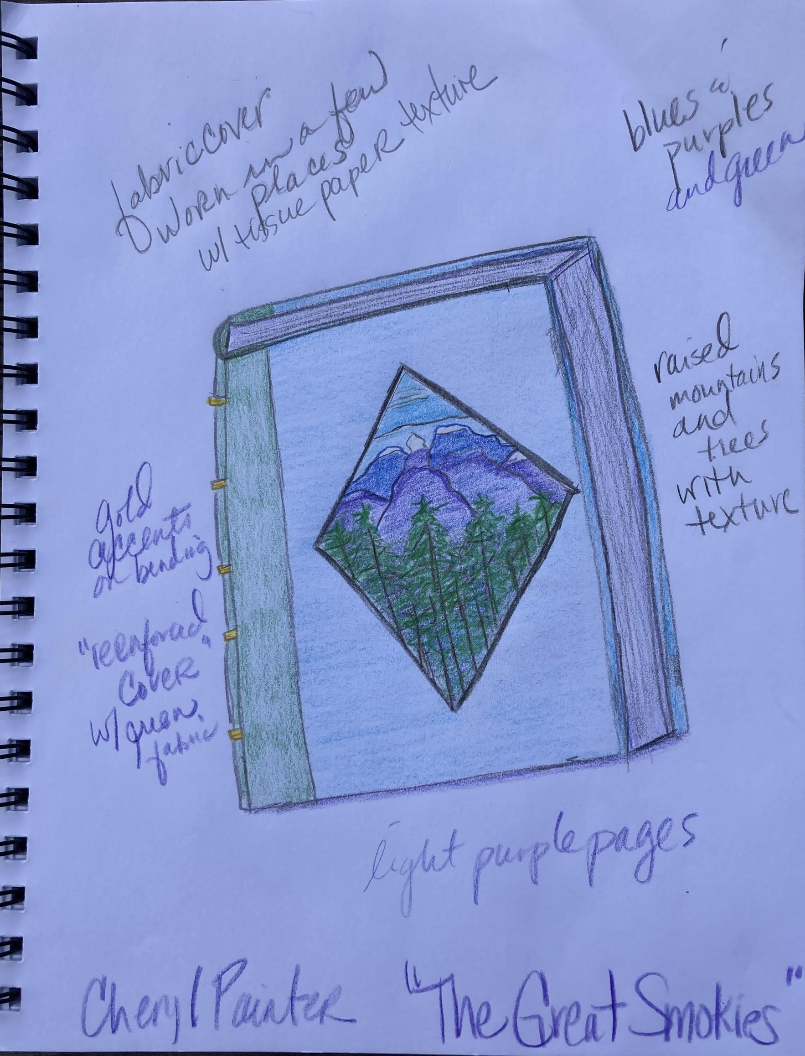
Next, draw a rendering!
Before moving on to making our cereal box book. It’s important that you have a plan in mind. This rendering should be your most ideal picture of what the book will look like.
Here is the rendering for the Smoky Mountains book.

Slide 9
Now upload your rendering on this slide.

Slide 10
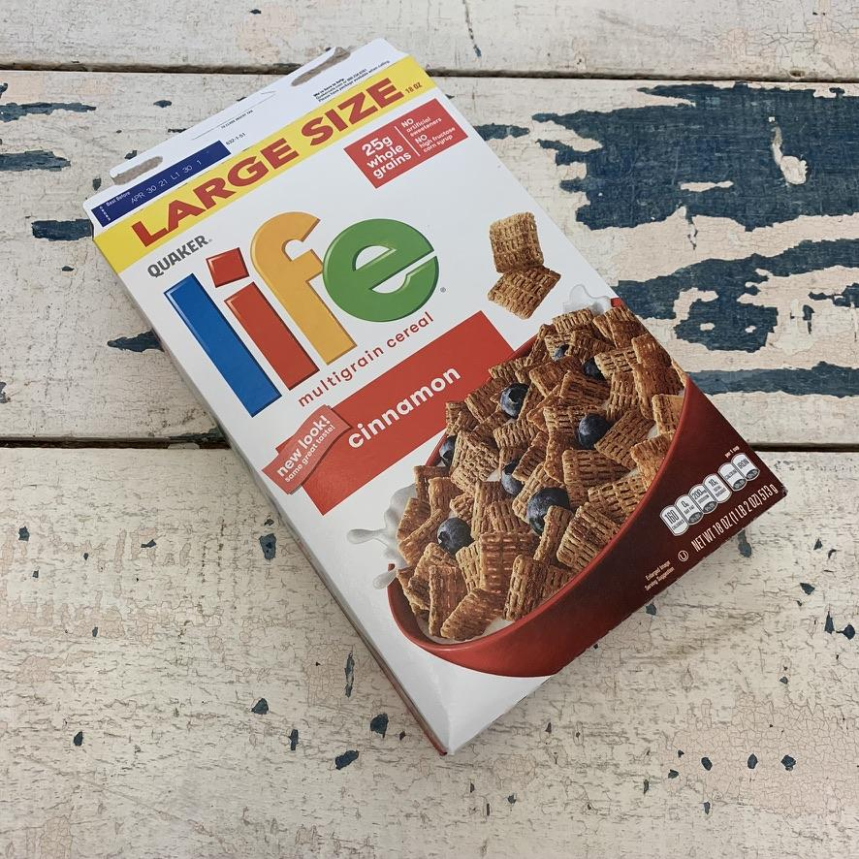
Let’s get started!
Most cereal boxes will work. Try not to get the Giant “feed a small army” size. The reason for that is that your paper will need to fit it. This Life Cereal box was just about perfect. You’ll see some of the adjustments made later.
Start with taking out the cereal. I recommend eating it!

Slide 11
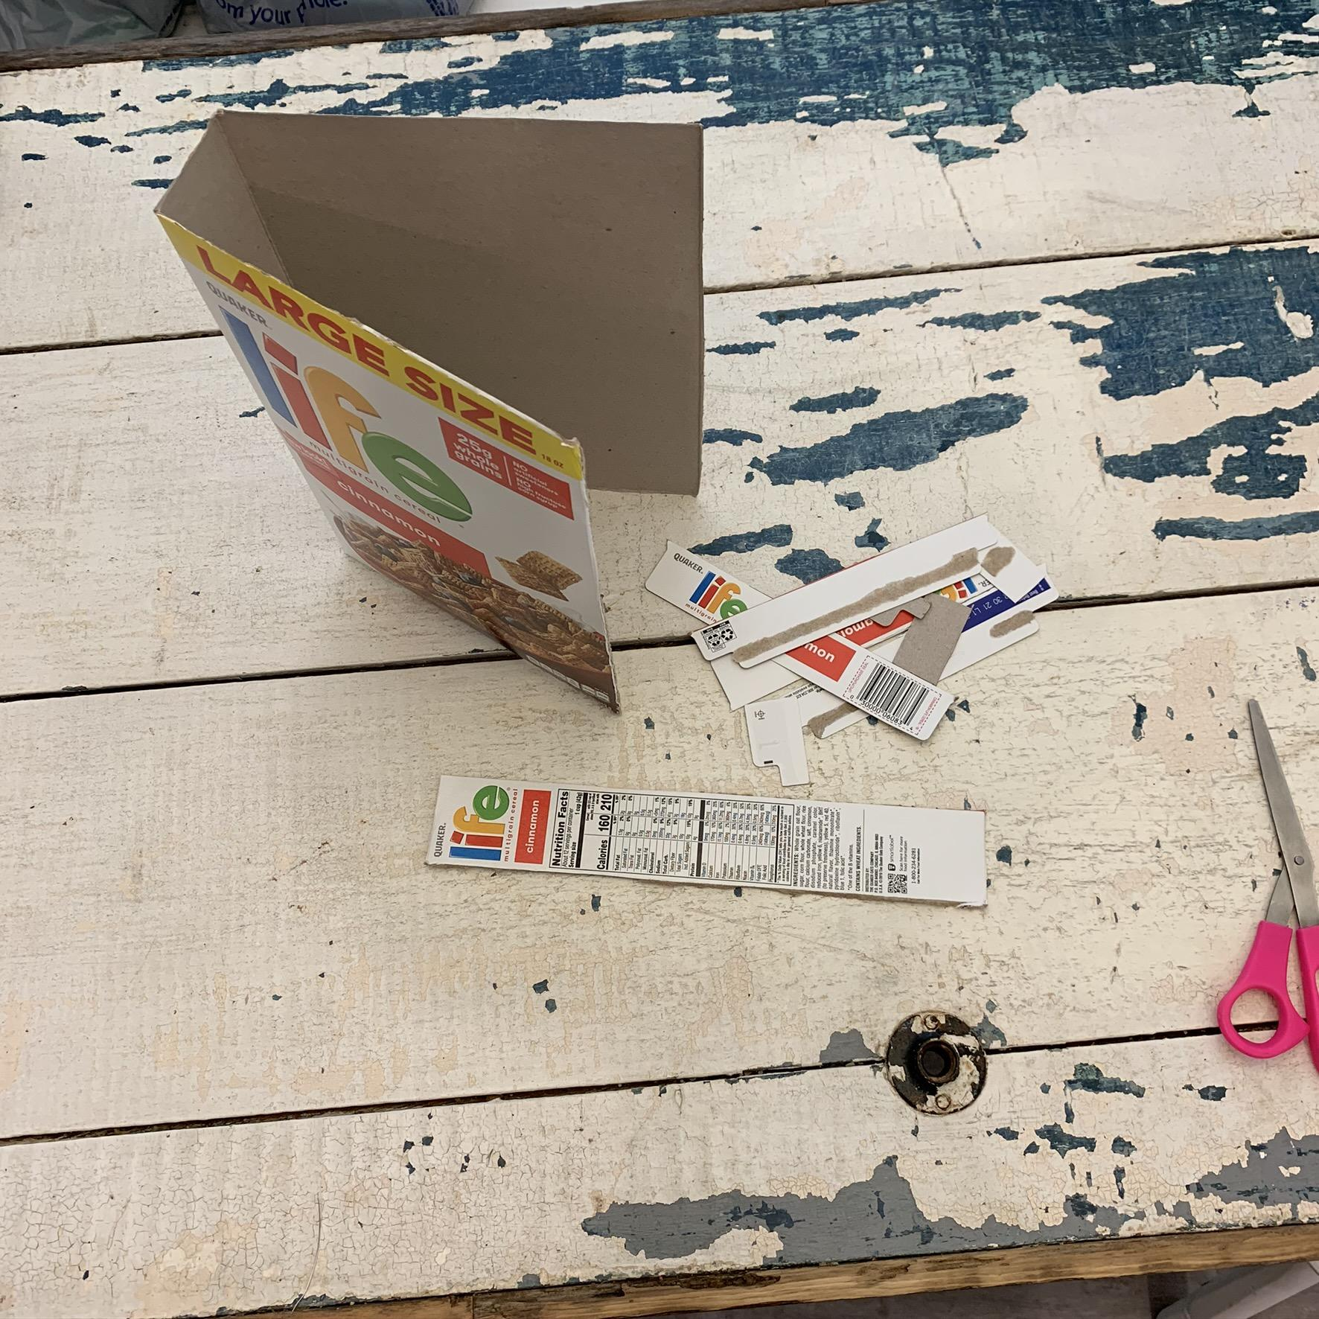
Step one
Cut the top, tabs, and side off of the box so that you wind up with your box looking like this.
You can throw the top and bottom away.
***Be very careful cutting the one side because we are going to use it later!
This is very important to keep!

Slide 12
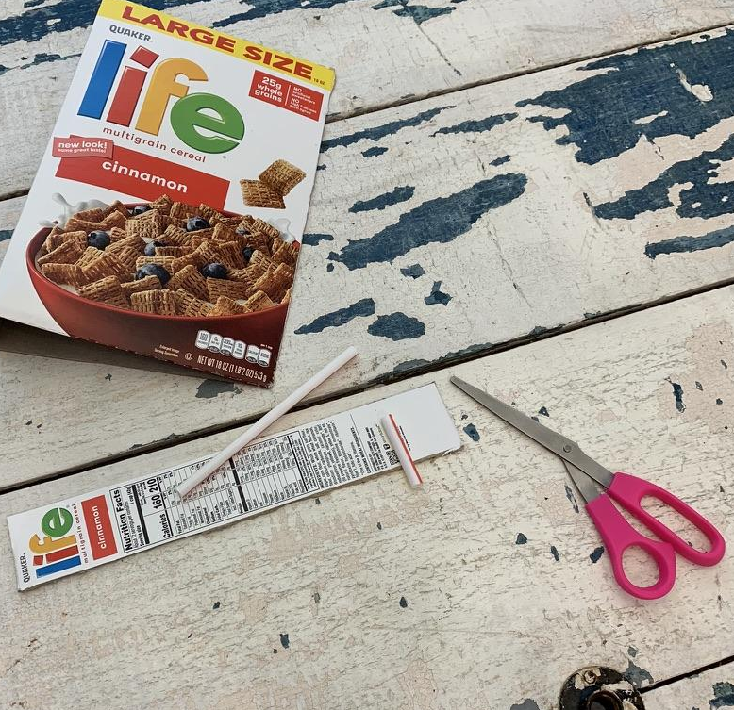
Step two
Next you’ll take your straw, and cut it to the width of your side piece. You’ll need a total of 4 of these. I was able to get all 4 from 1 straw.

Slide 13
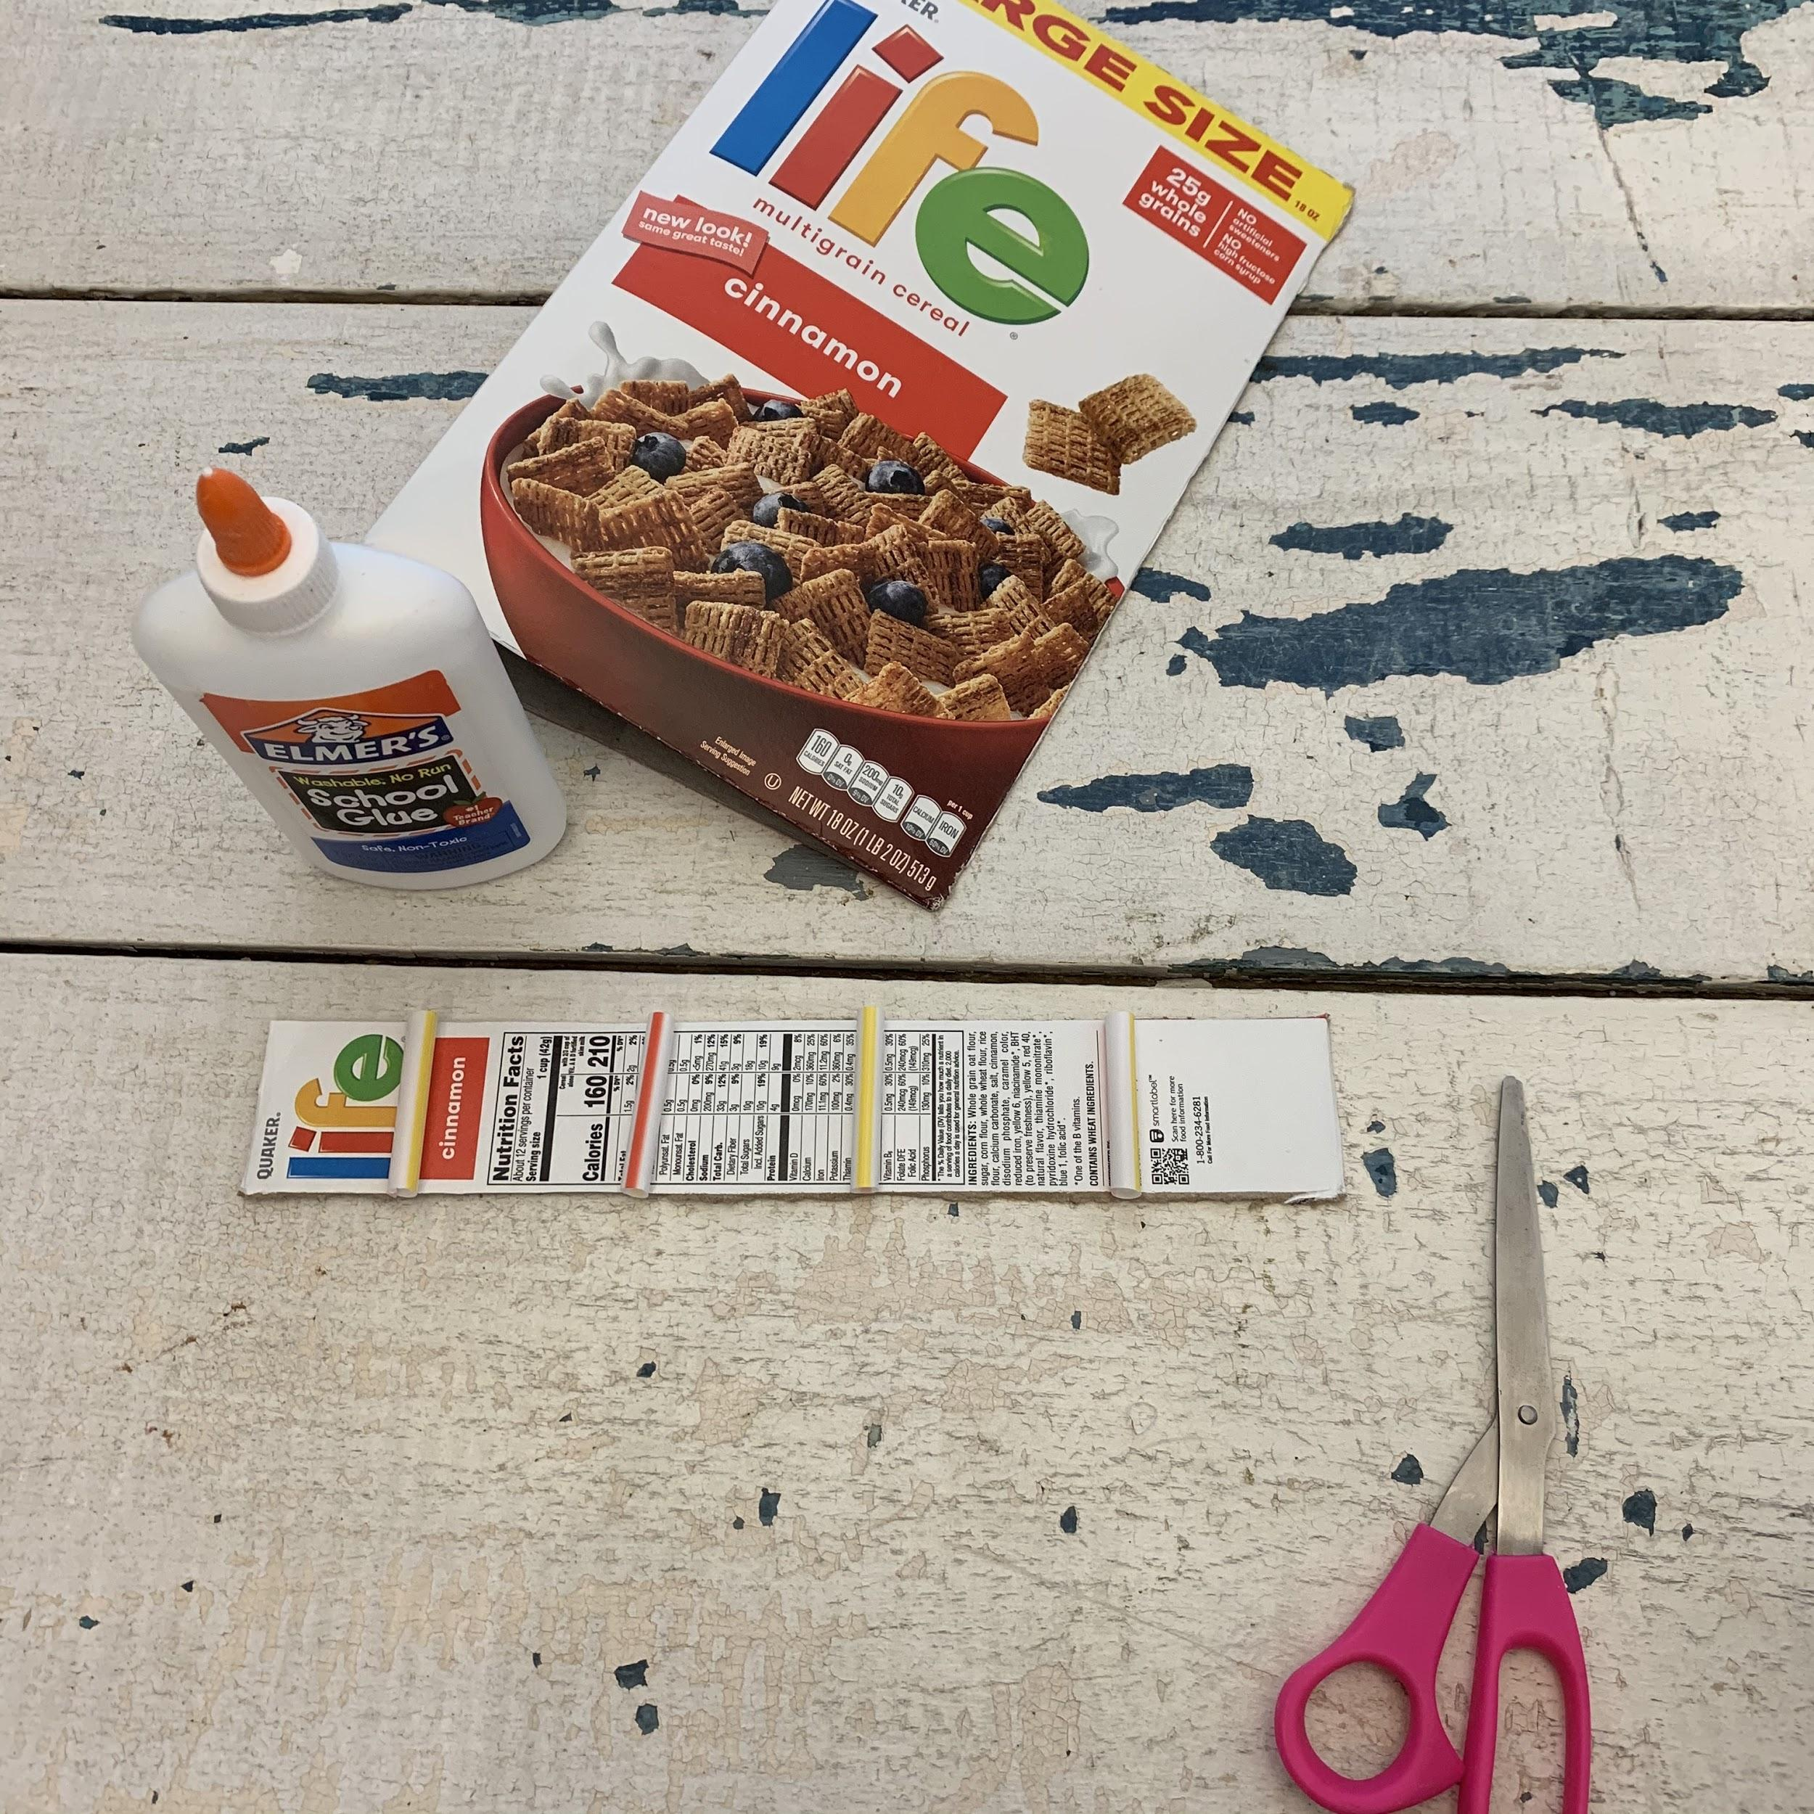
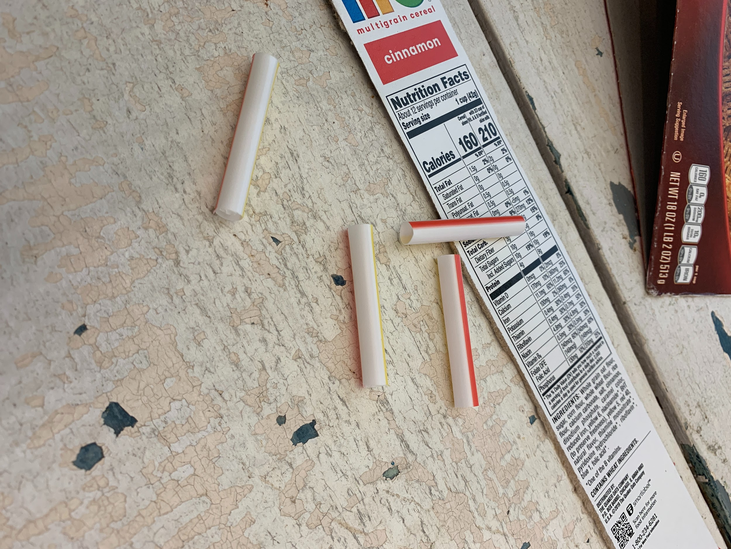
Step three
You’re going to glue the 4 straw pieces to your side piece evenly spaced out.

Slide 14
Step four
You’re going to take your fabric (that goes with your theme) and cut it with about 1.5” spare on each side of your side piece
Then, You’ll begin using the hot glue (CAREFUL IT’S HOT!!!), to glue the fabric onto the side with the straws. Be sure to glue one section at time and tuck the fabric up to the straws so that you get a nice binding bump.

Slide 15
Step five
Cut Here
Cut Here
Small Side
After you’ve glued the front, flip the binding over and you’ll make a diagonal cut from the corner of the fabric to the corner of the cardboard.
Then, glue down your small sides first followed by your long side.
Long Side
Long Side
Cut Here
Small Side
Cut Here

Slide 16
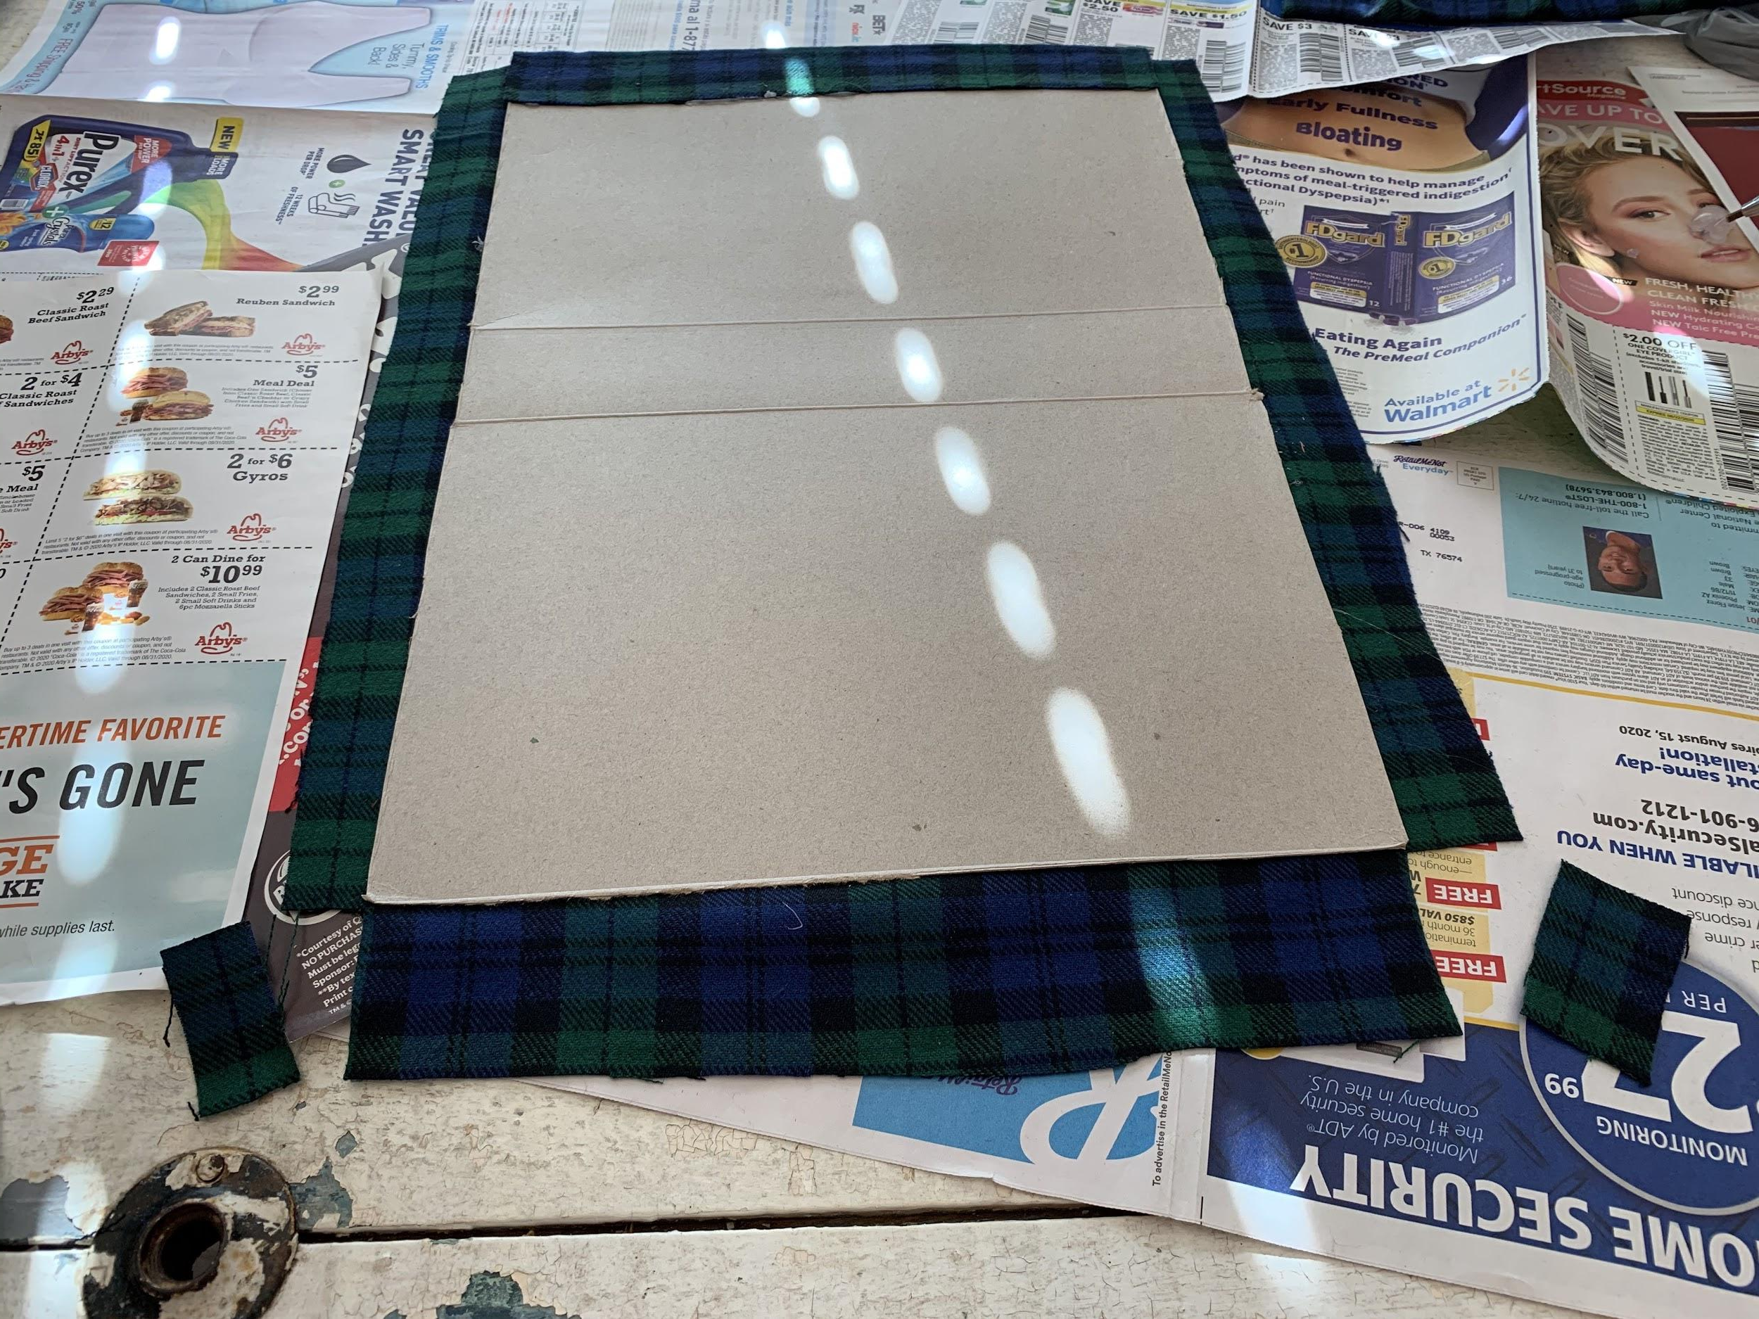
Step six
Next, lay your fabric out and cut enough fabric to allow for 1.5” on the long side and 2” on the short side.
After you have your fabric cut, lay your unfolded box centered on the fabric. Then cut the corners off of all four corners.
1.5”
2”

Slide 17
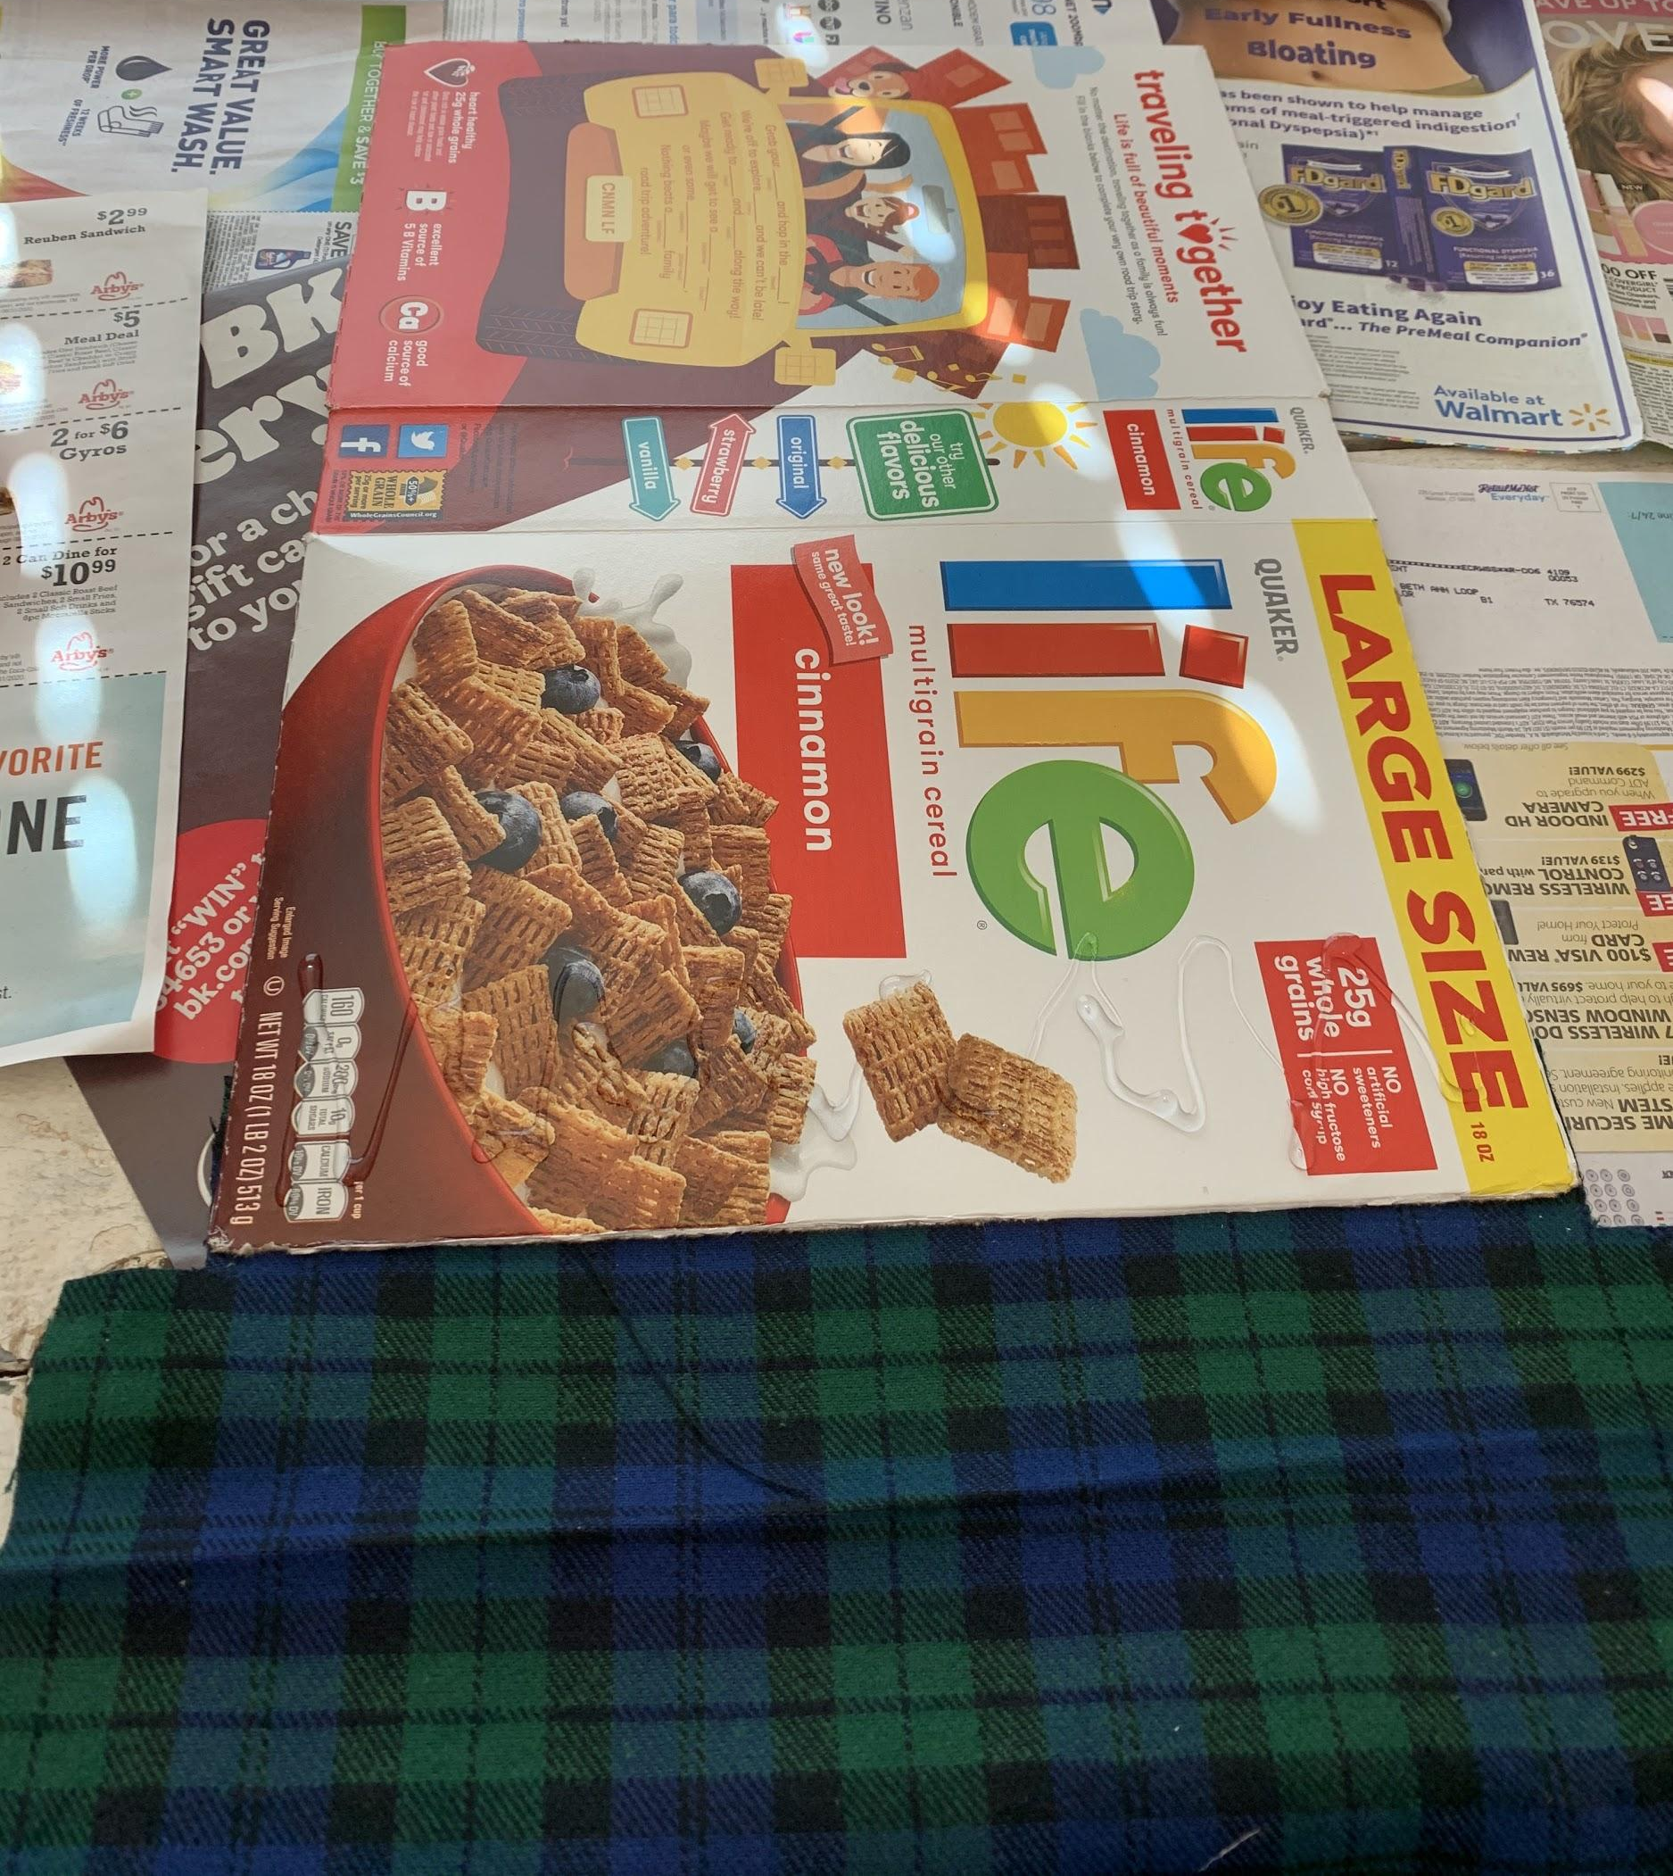
Step seven
Step 3
Then work your way across
First you’ll hot glue one of the short sides to the brown side of the box.
Then flip the board and fabric over and you’ll begin glueing and smoothing the fabric down as you go across the box.
***Only do small sections at a time so that the hot glue doesn’t dry.
Step 2
Start small gluing only a small section at a time
Step 1
This side is already glued underneath

Slide 18
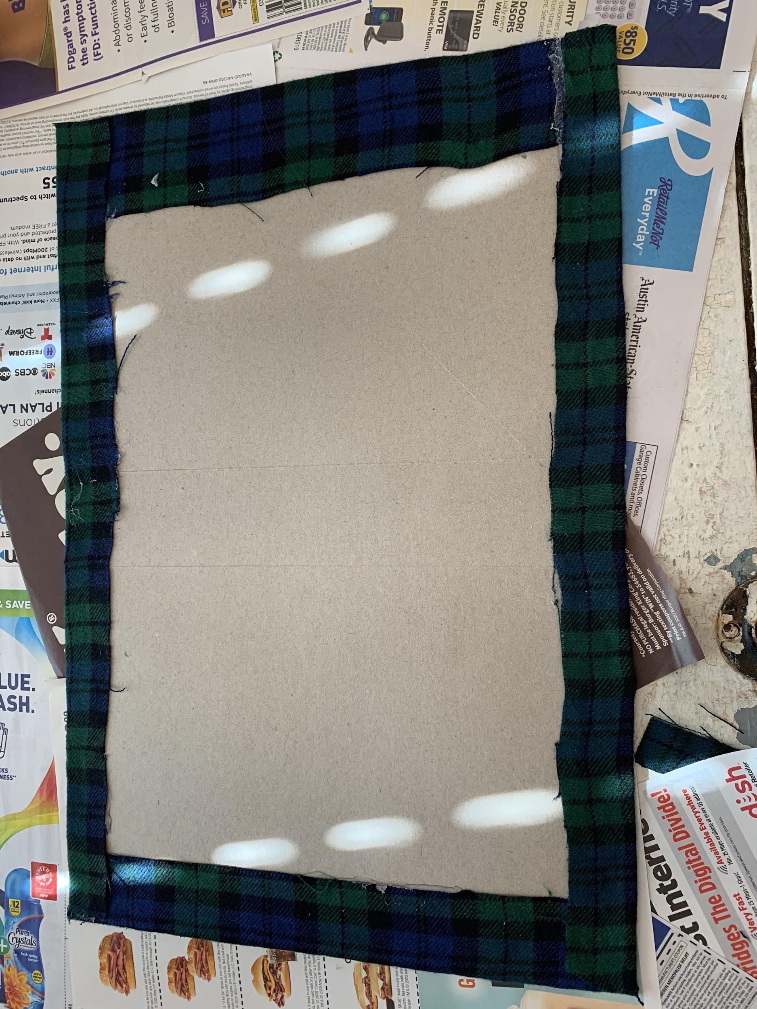
Step eight
After you’ve glued the rest of the glossy side down, flip the box back over and glue the other short side. Then, glue the long sides down.

Slide 19
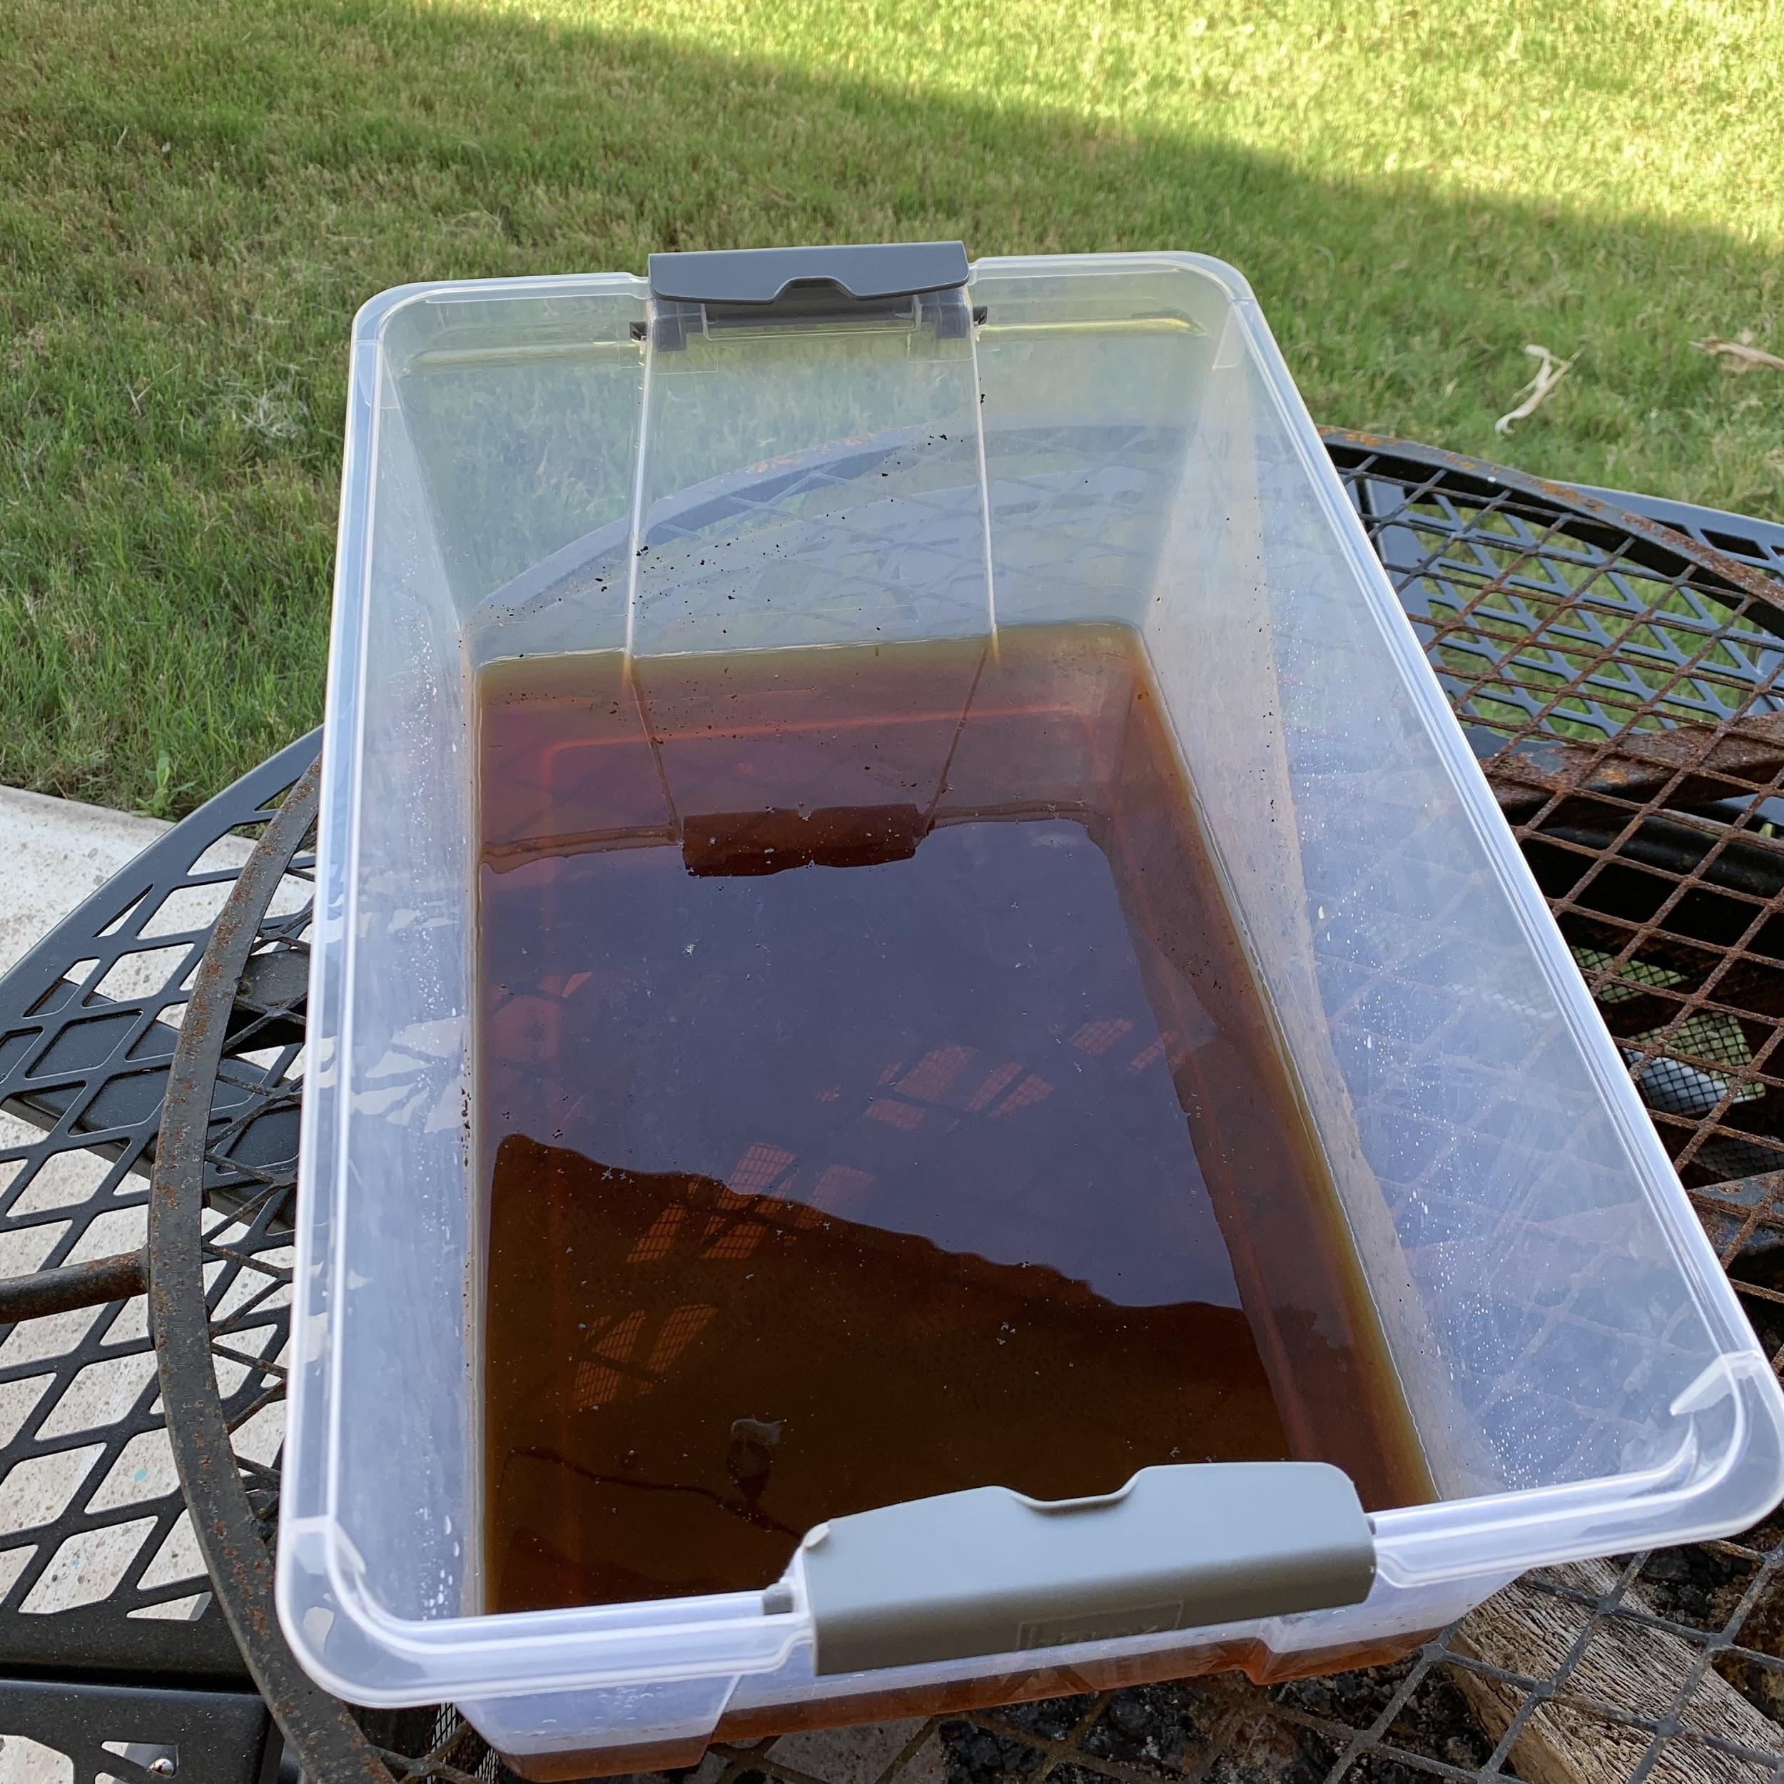
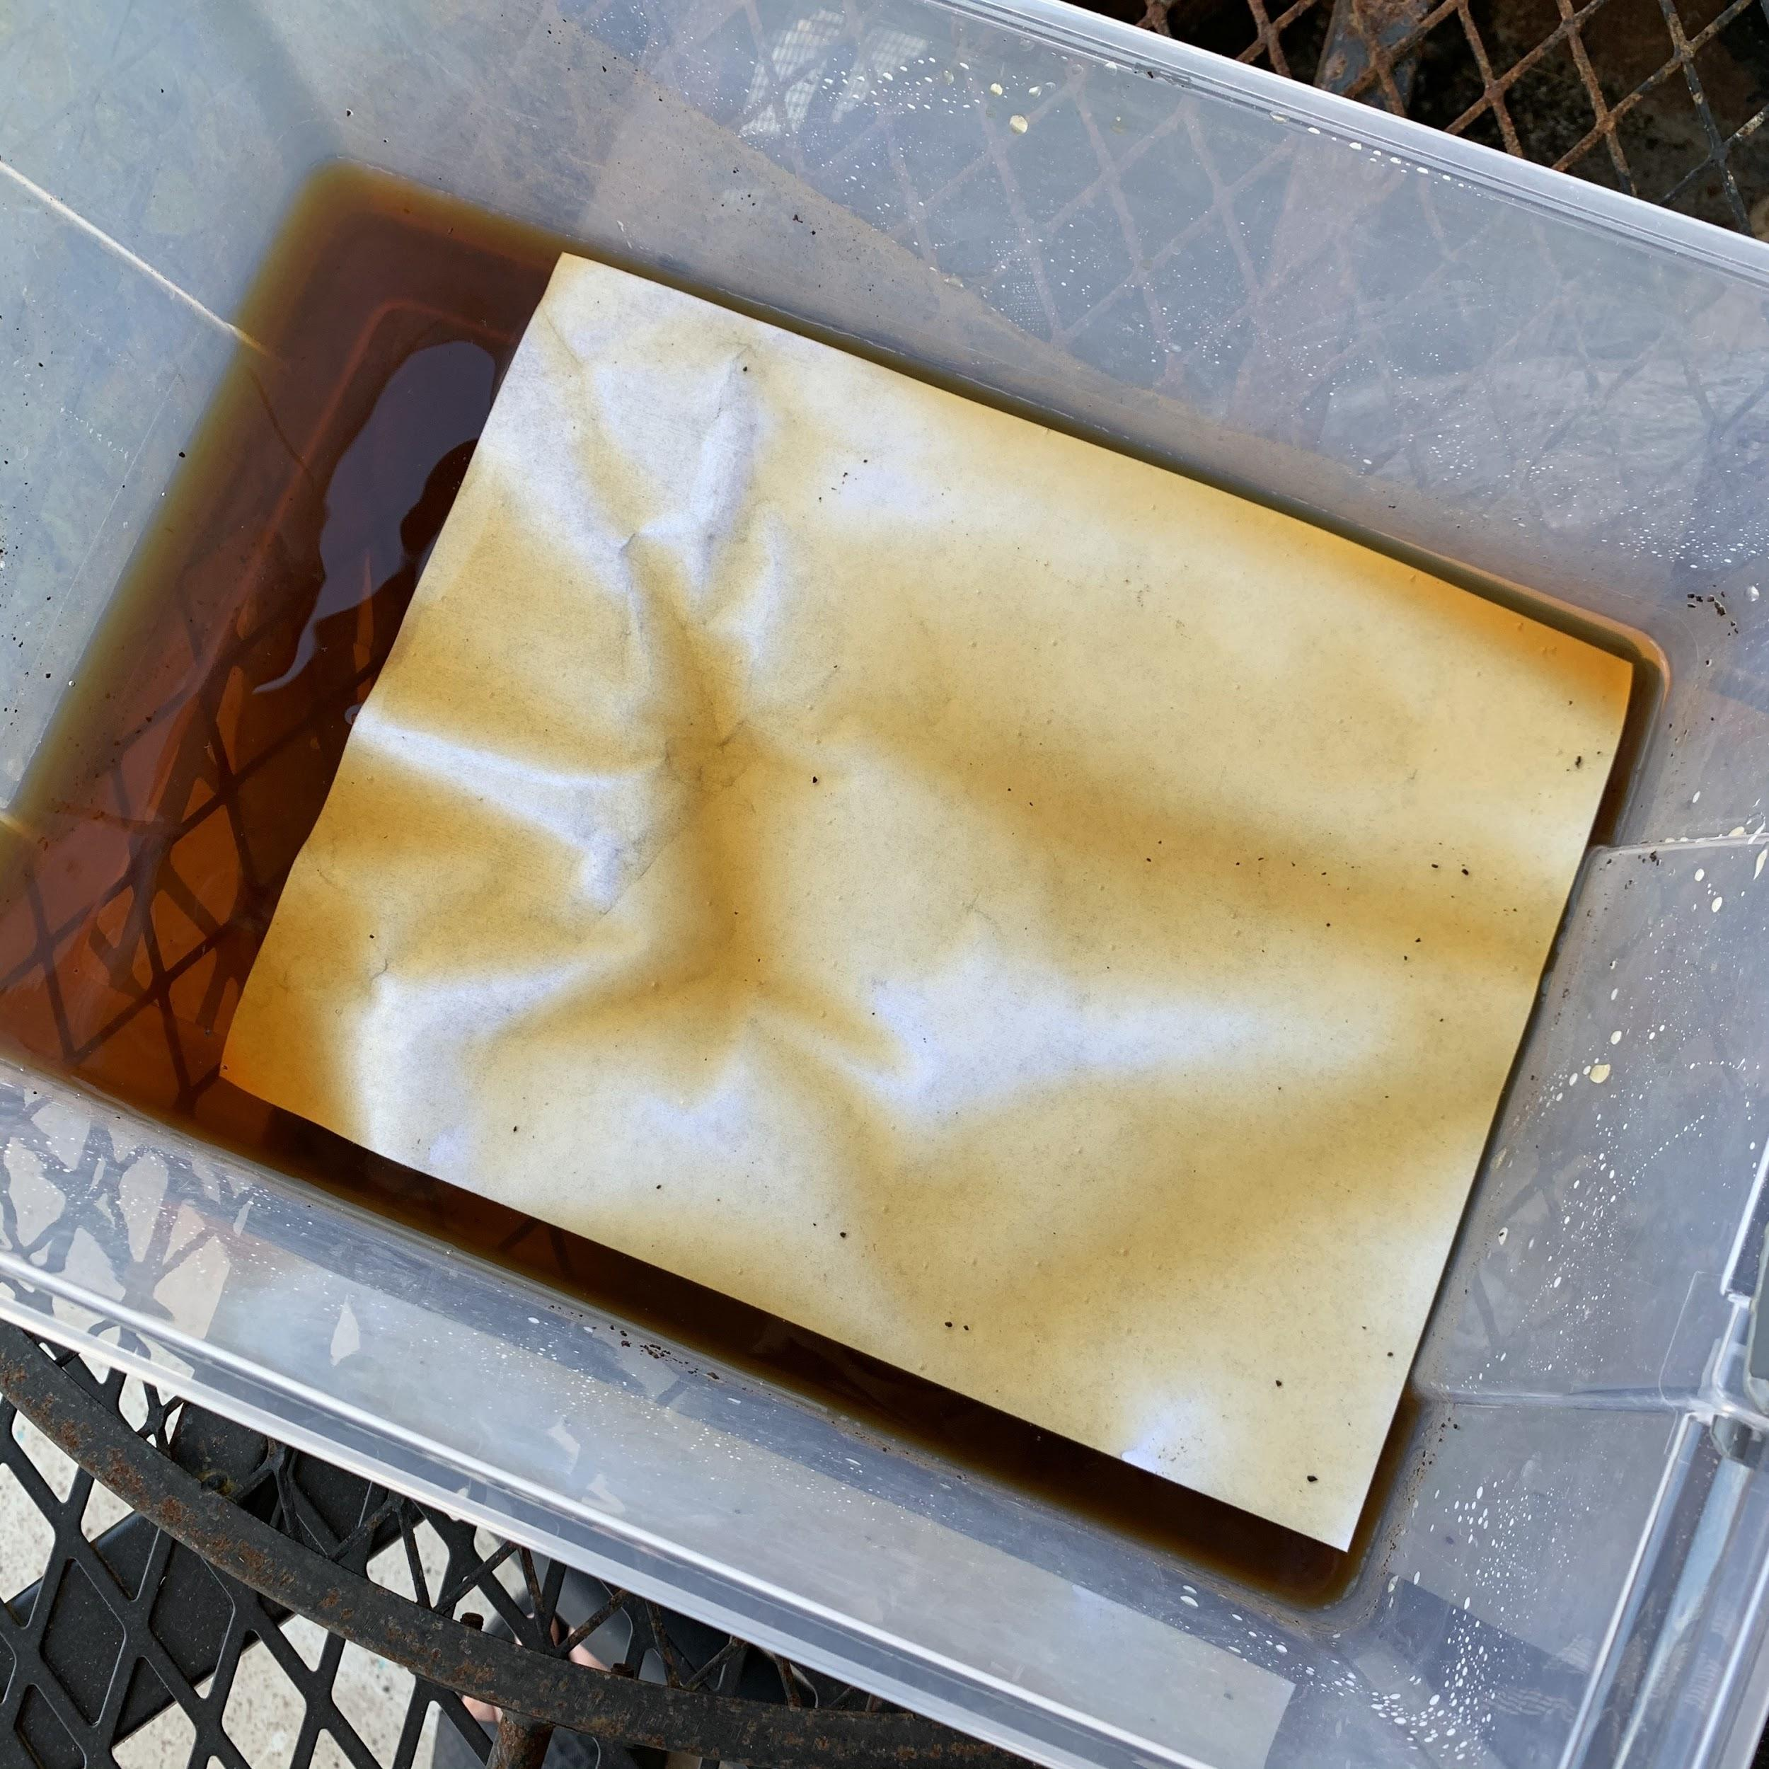
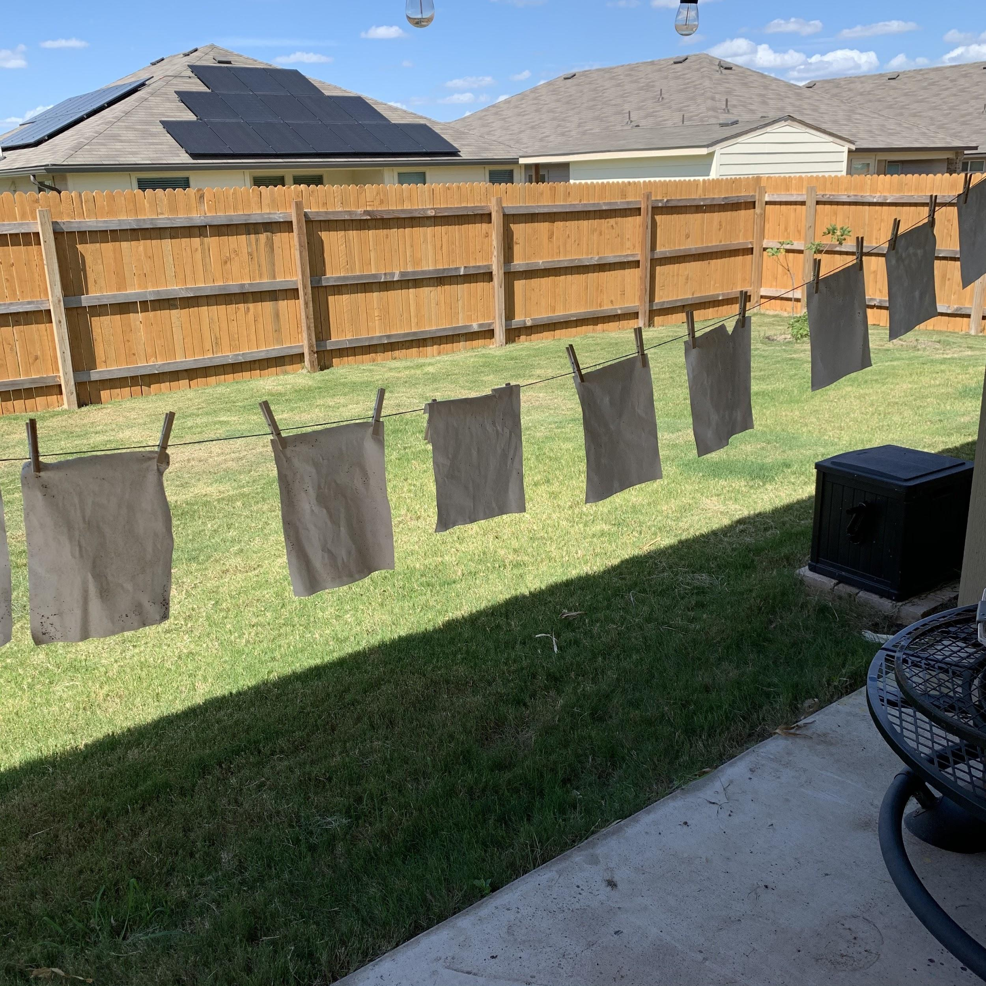
Step nine
Next we get to move on to the pages! You’ll need some sort of a bowl or bucket, coffee grinds/tea, water, and paper.
Make a dark tea/coffee water.
Dip the paper for about 10 seconds and then take it out and either lay it out to dry or hang it up if you can.
I made 32 pages and it worked pretty well.

Slide 20
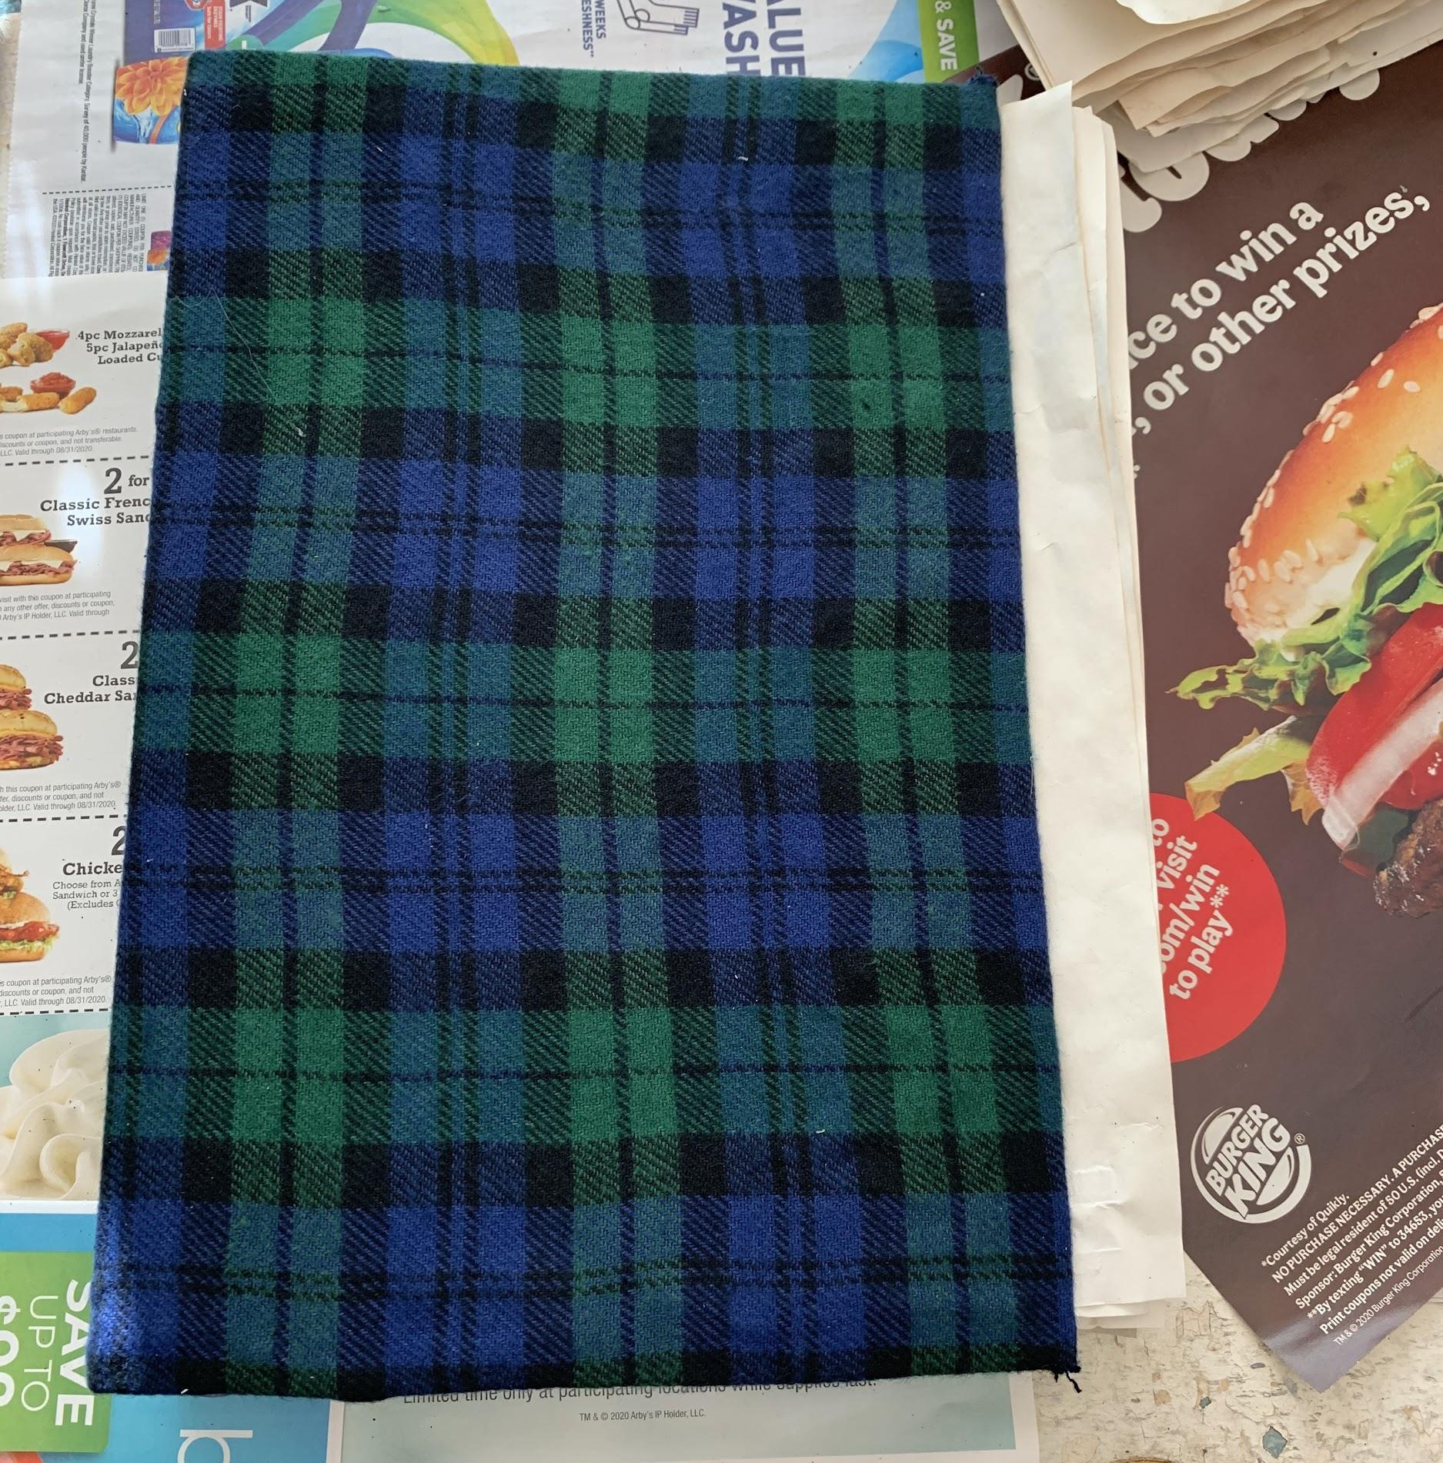
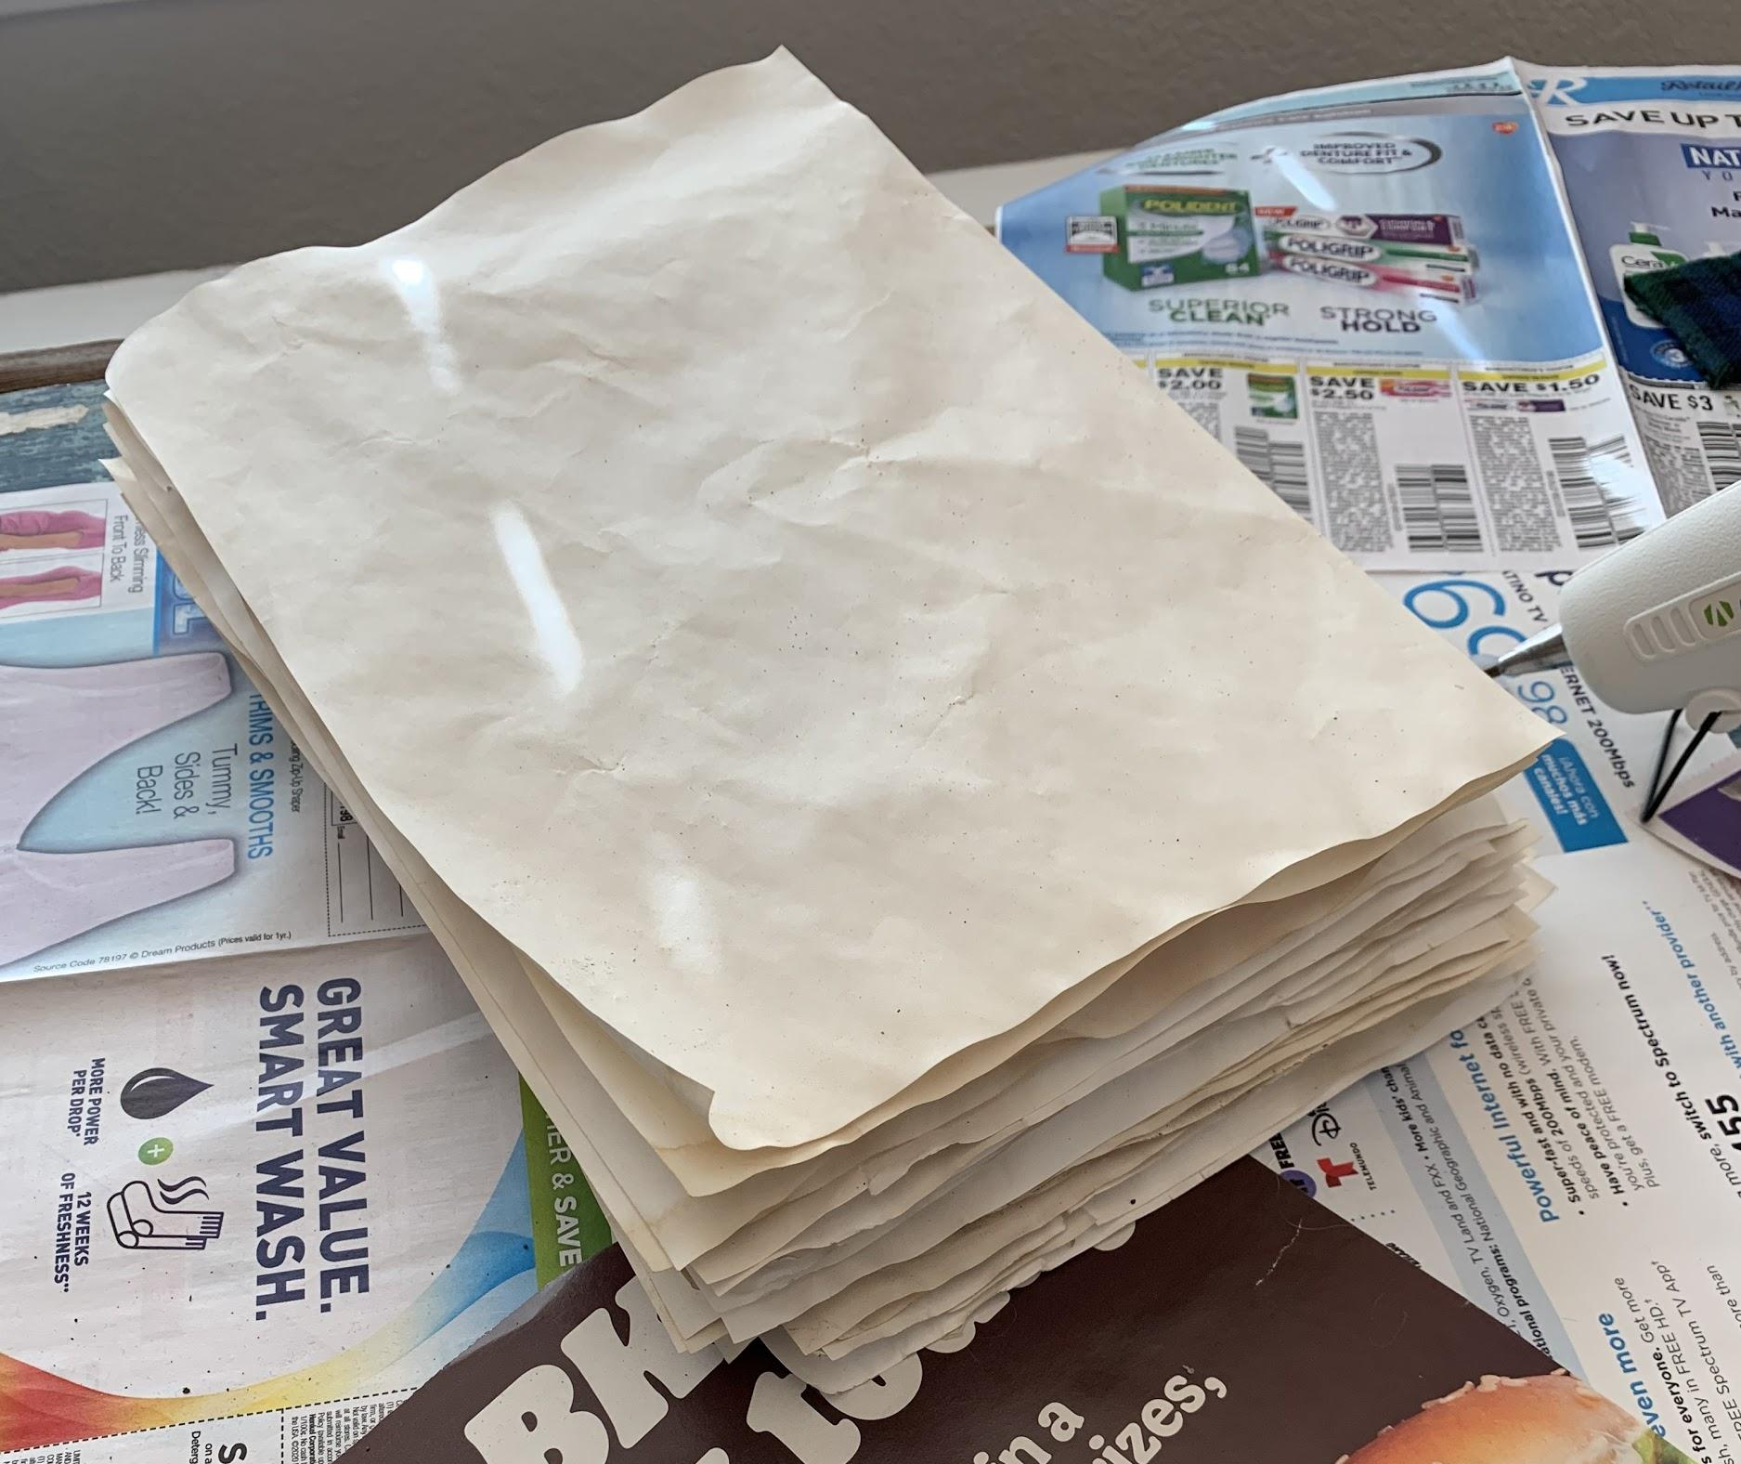
Step ten
I cut my paper down
After your pages have dried (mine took about 30 min), then make sure that they fit. I had to cut about 2” off of mine.

Slide 21
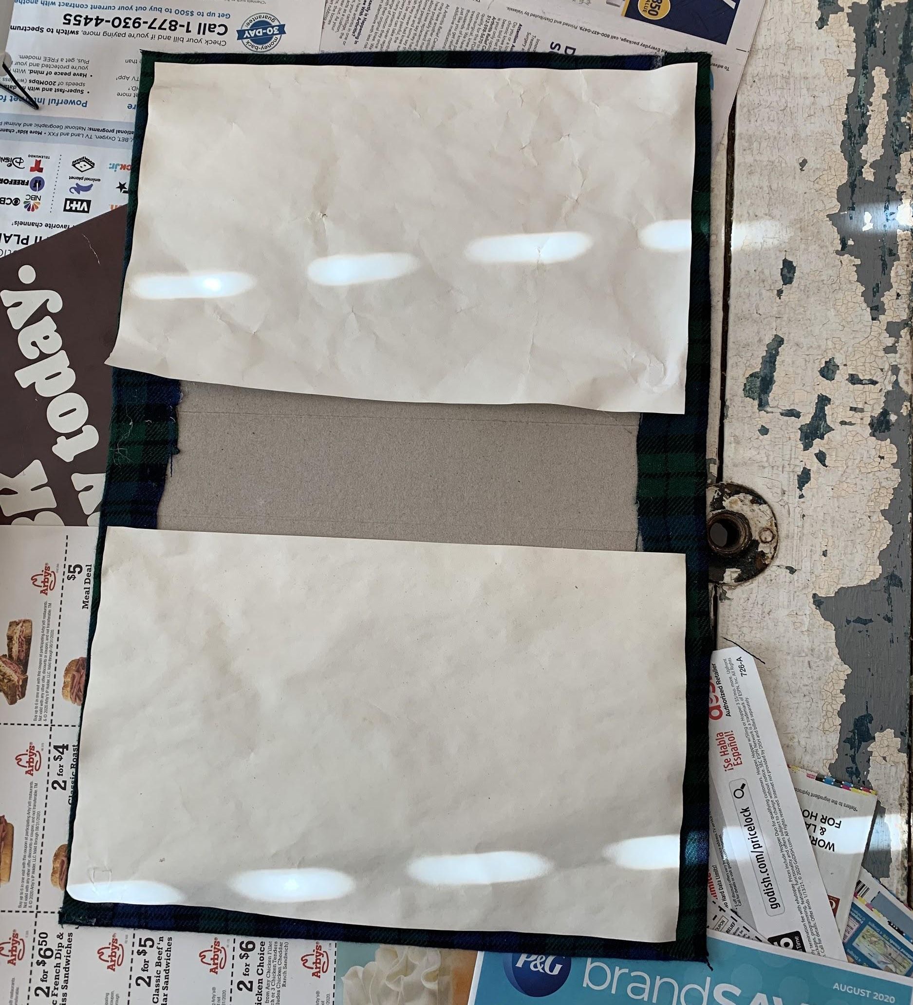
Step eleven
Next, glue two of your pages to either side. The goal is to cover your seams of the fabric.
Then, you’ll line all of the rest your papers up and put a lot of hot glue along the binding, quickly!
Then set the papers (Make sure they’re lined up!!!) in the hot glue and give a little bit of pressure till the hot glue dries.

Slide 22
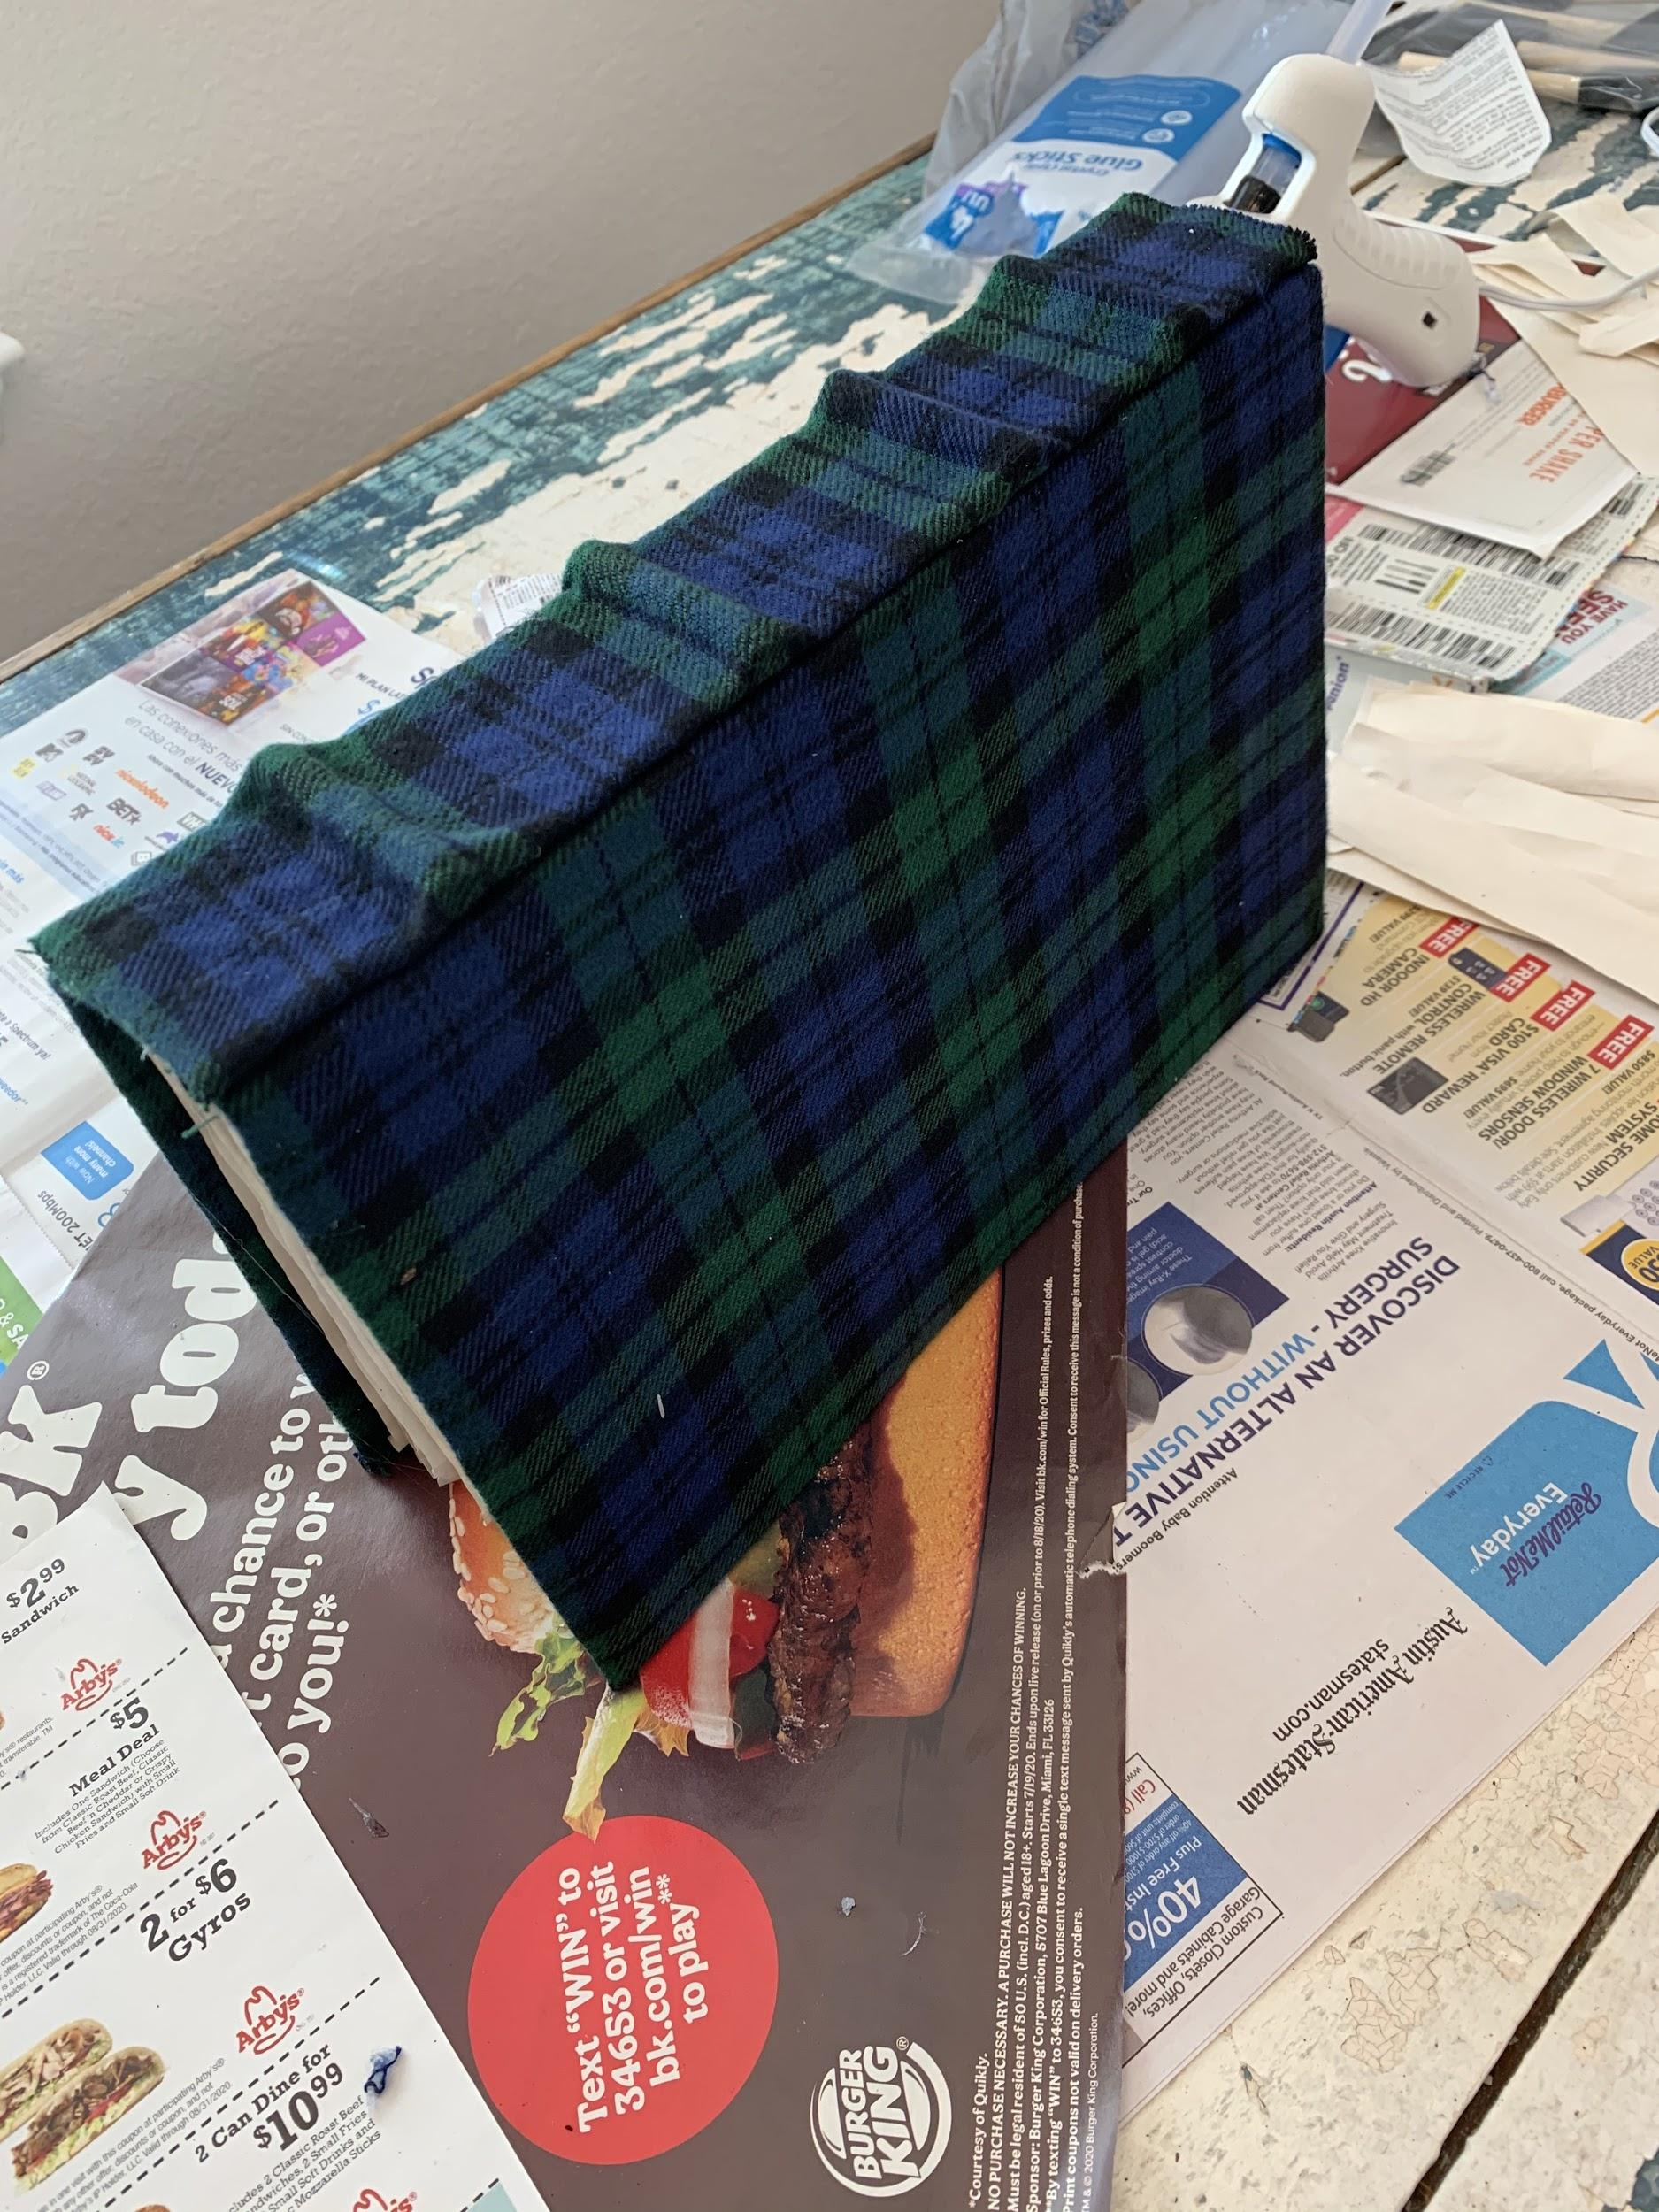
Step twelve
Remember that side piece that we glued the straws and fabric to?
It’s Time!
Use a generous amount of hot glue on the binding and then press and hold the side piece on the binding.
If needed, run a bead of hot glue along the seam.

Slide 23
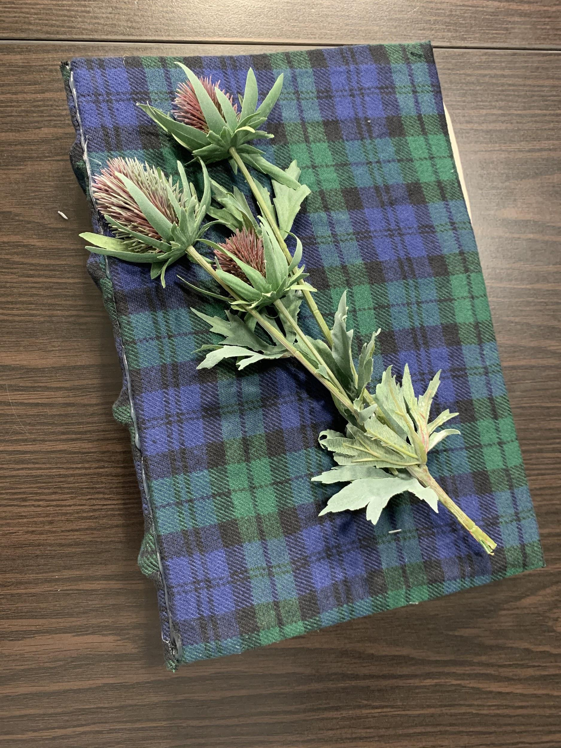
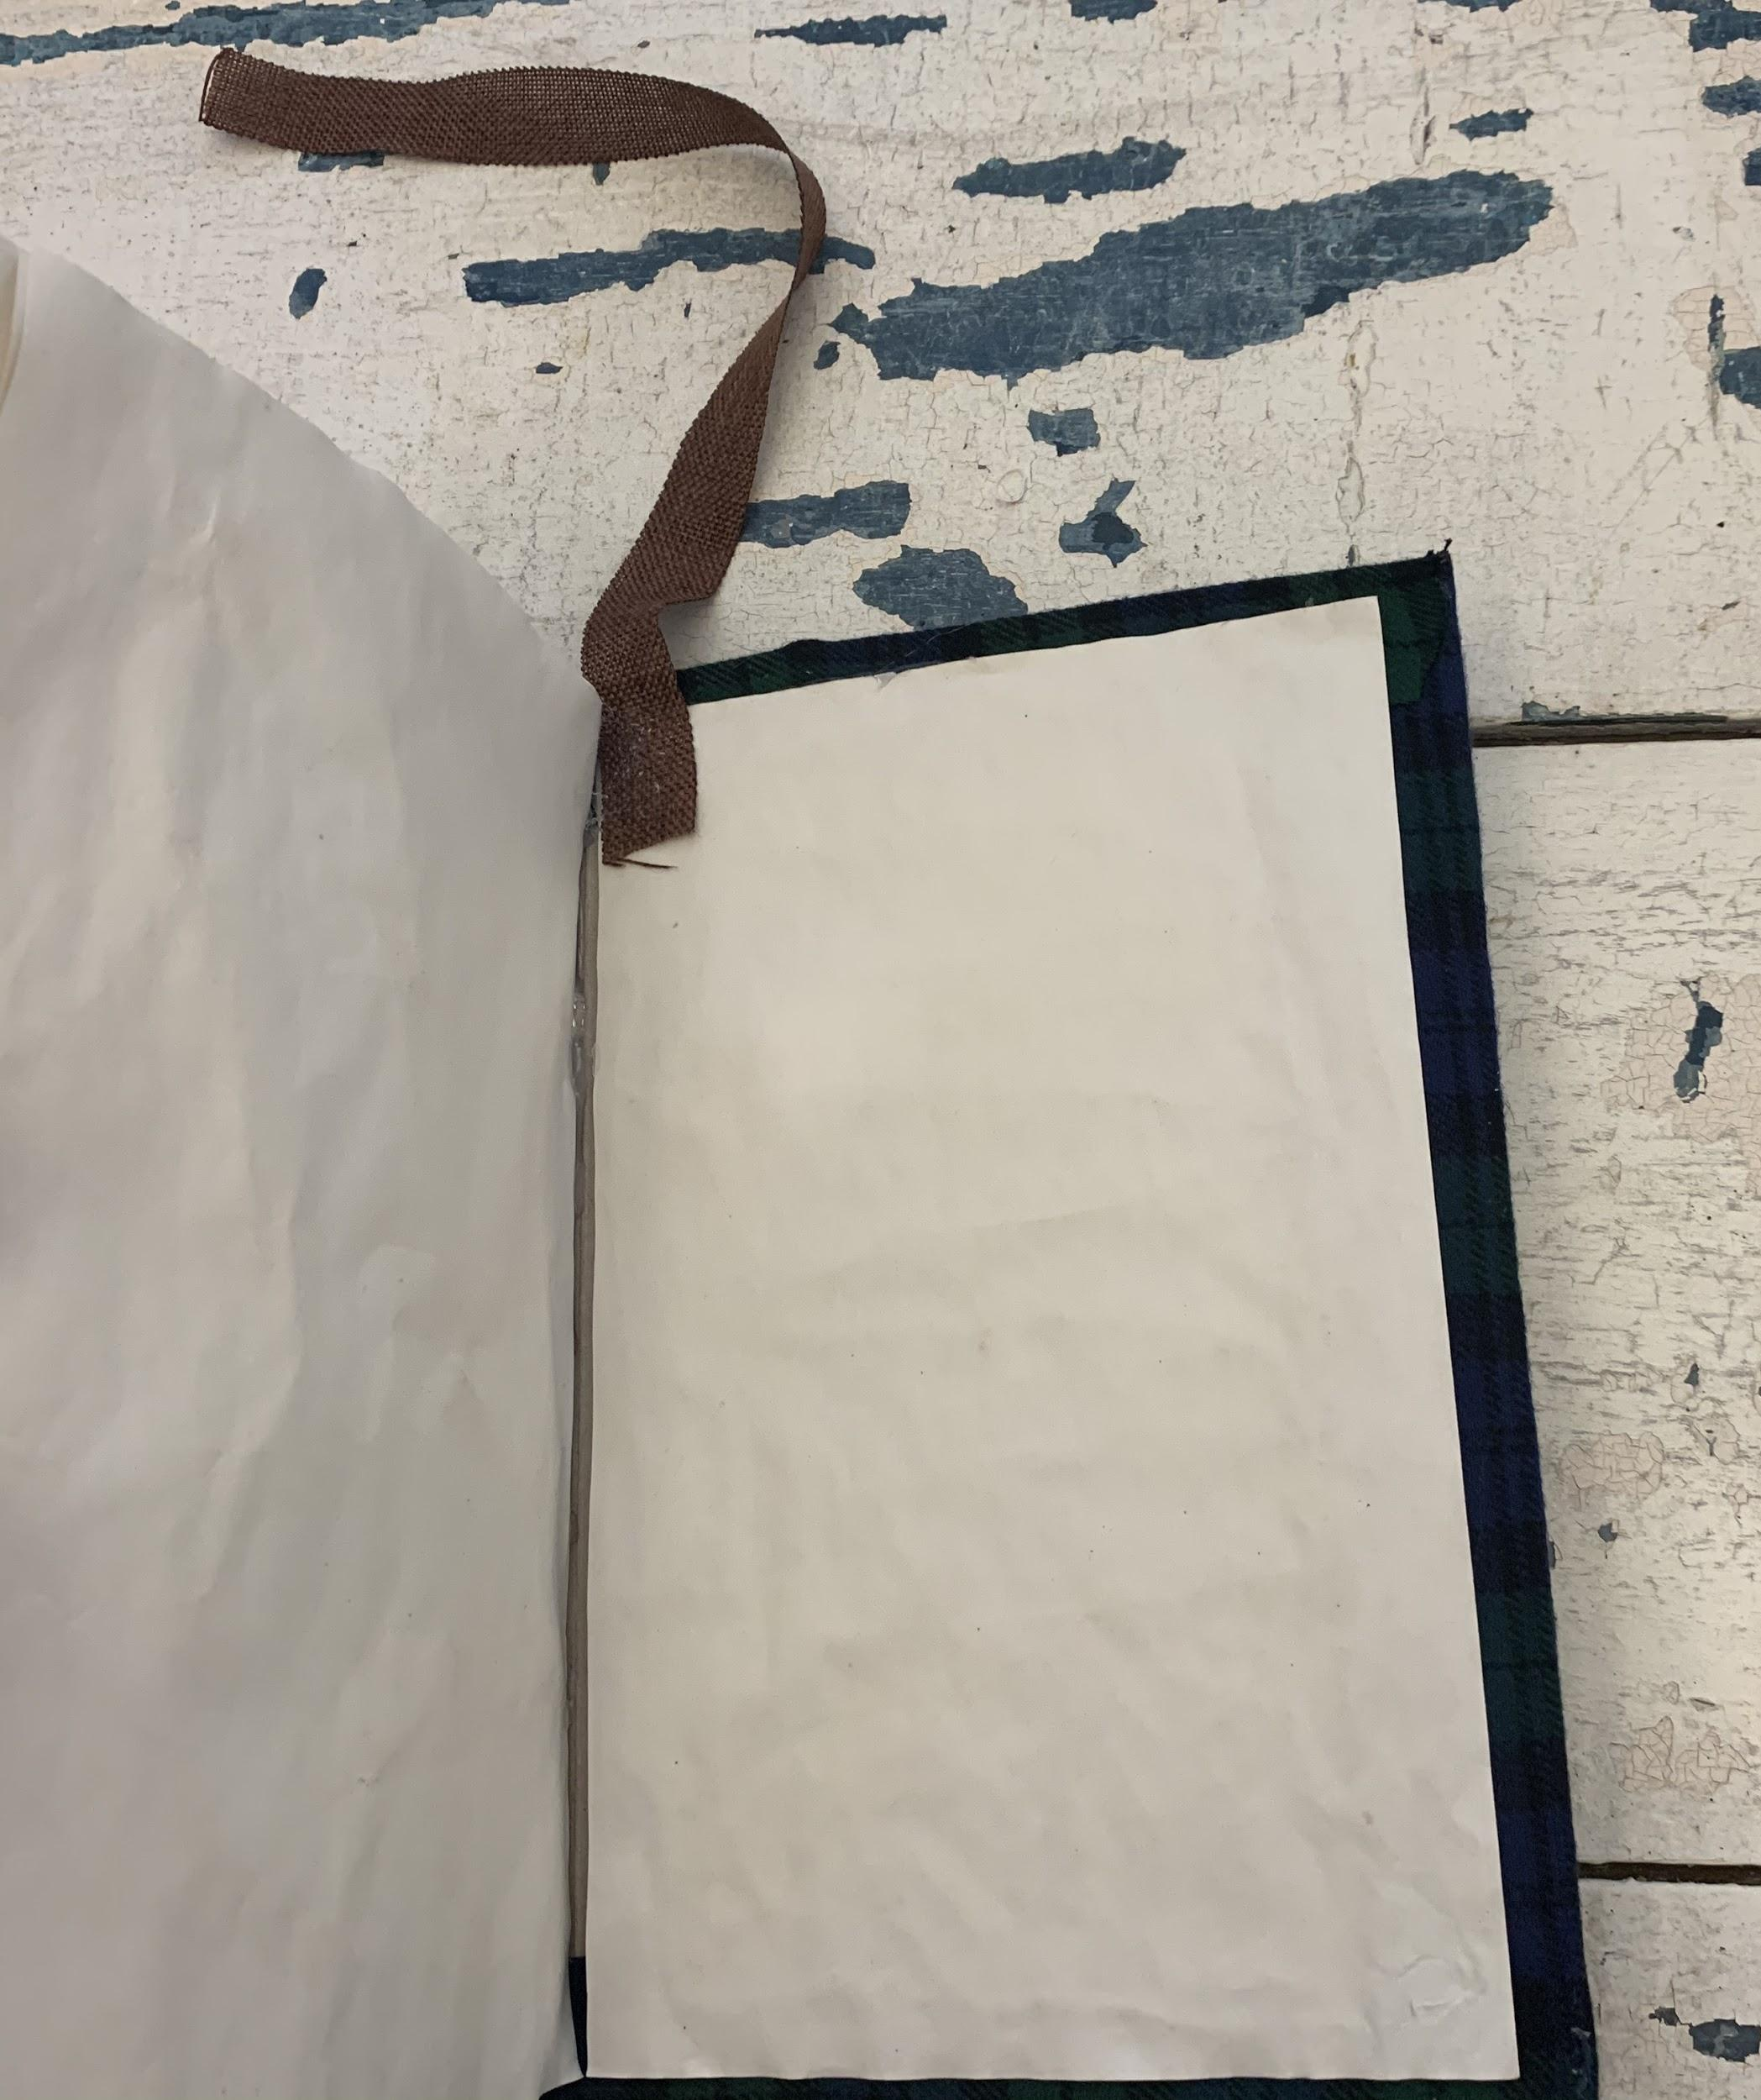
Finishing Touches!!!
Got this thistle from Hobby Lobby for $3
You’ve made it this far! Woohoo! Now it’s time to give it the live and the uniqueness that makes it scream your theme!
For the Scotland book it was adding the thistle(The National Flower of Scotland) and the brown, earthy ribbon.
I hot glued the ribbon to the center top of the back of the book.

Slide 24
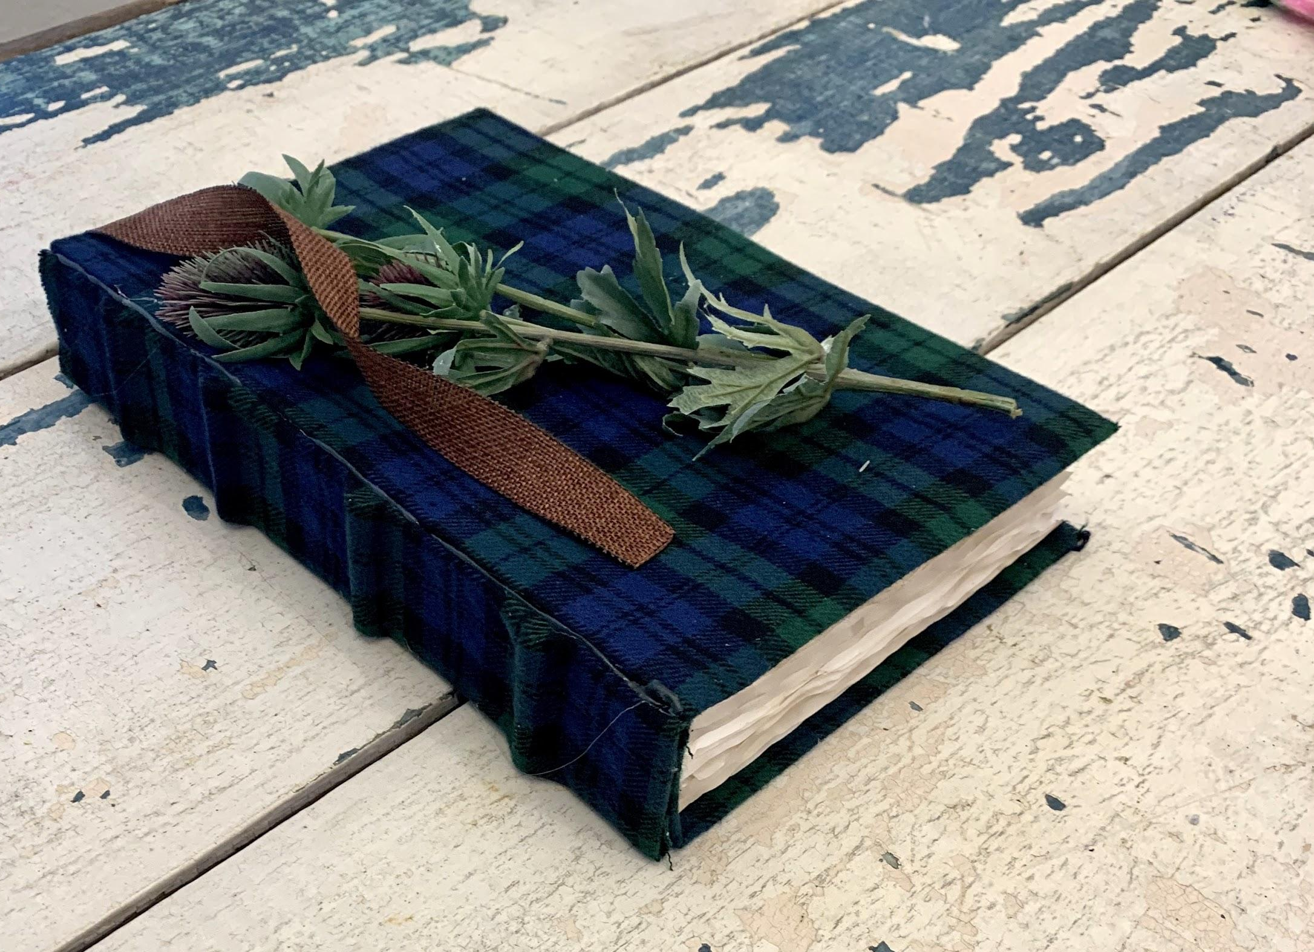
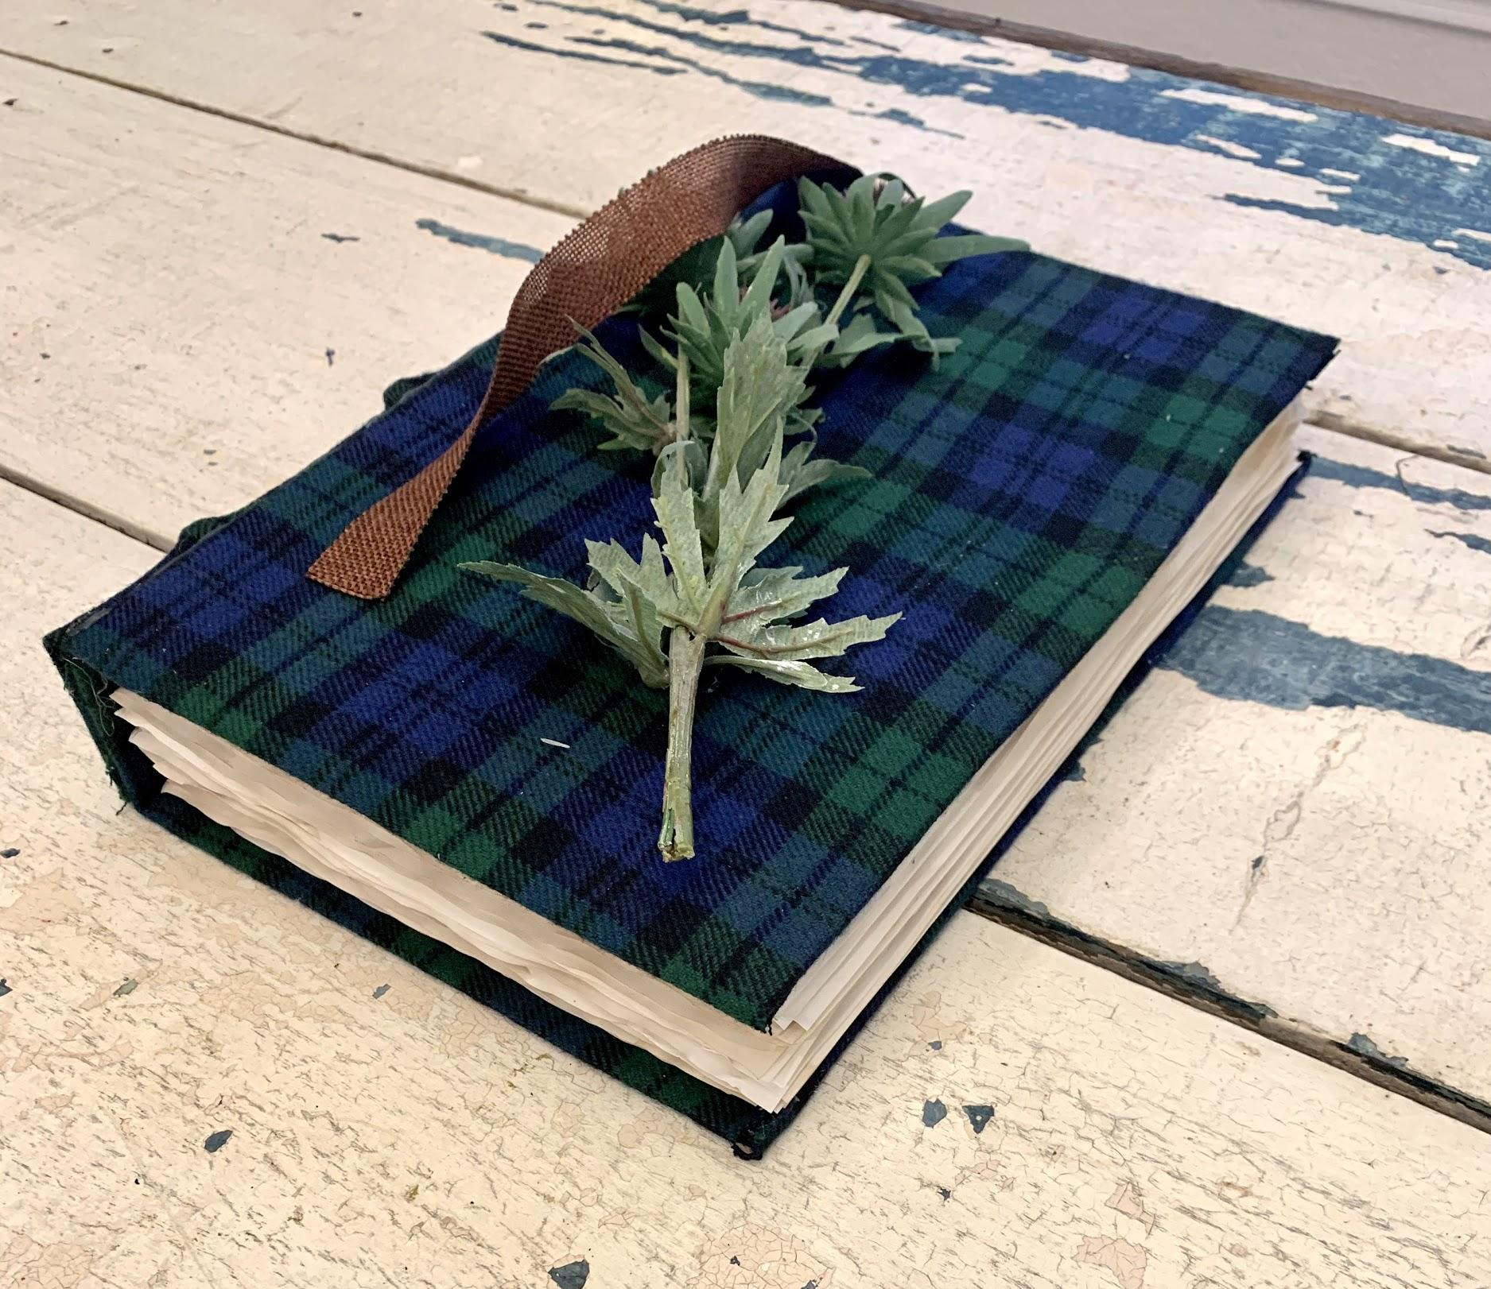
Finished Product

Slide 25
Now upload yours!
Make sure that you give multiple angles of your book.

Slide 27
A minute to reflect.
What was the most difficult part of making your book (2-3 Sentences)?
What was the most fun part of making your book (2-3 Sentences)?
If you could change one thing about your book, what would it be and why (2-3 sentences)?

